Slide 1
Building a Healthy Body
Dr. Melanie Trowbridge, ND, LAc
This presentation is not meant to diagnose, treat, or offer medical advice.
For education purposes only.

Slide 2
Many Definitions of ‘Healthy’
Adequate Energy
Freedom from Chronic Pain
Healthy appearance of Skin or Hair
Ability to use Muscle / Bone for exercise
Weight that supports function of other body systems
Good Appetite / Good Digestion
Positive Outlook or Ability to Persevere in Life through difficulties

Slide 3
Increasing the Field of ‘Healthy’
Differently-abled individuals may not meet previous definitions of ‘healthy’
Also as we age, or as systems break down, we must look for new definitions of ‘healthy’
Healthy = Operating at your own best potential level of mind, body, and spirit

Slide 4
Most Common Western Diseases
According to the CDC: 6 in 10 Americans are living with a Chronic Disease
Heart Disease & Stroke, Cancer, or Diabetes are the leading causes of Chronic Disease
“We know that most chronic diseases can be prevented by eating well, being physically active, avoiding tobacco and excessive drinking, and getting regular health screenings.”
Source: Retrieved 12/28/22 from https://www.cdc.gov/chronicdisease/

Slide 5
Chronic Inflammation
Immune response to harmful stimuli (injury / infection)
Defined by pain, heat, redness, swelling, loss of function
Inflammation is a normal repair process
Chronic inflammation is a disease
Blood markers of inflammation include C-Reactive Protein (Connection with depression)
Most “-itis” conditions (vasculitis, diverticulitis)

Slide 6
Causes of Chronic Inflammation
Poor diet: Foods that are pro-inflammatory include food allergens, processed foods / oxidized foods, diets high in Omega-6 / low in Omega-3, diets lacking in fruits / vegetables
Environment: Toxins, sick-building syndrome, noxious chemicals, airborne irritants
Stress: Cortisol elevation – prevents glucose storage – more circulating glucose, narrowing arteries. Epinephrine leads to increased heart rate.

Slide 7
Diseases linked to Chronic Inflammation
Autoimmune Diseases – Crohn’s, Ulcerative Colitis, Hashimoto’s Thyroiditis, Lupus, etc.
Diabetes – Chronic Inflammation → Higher TNF (Tumor Necrosis Factor) in the blood → Cell resistance to insulin
Allergies – Cause of inflammation and worsened by inflammation
Cancer – Researchers at MIT found a link between chronic inflammation of the intestines and increased DNA damage

Slide 8
Reducing Inflammation
Increasing Organic Whole Foods – Antioxidants
Increasing Omega – 3 Foods – Fish, Flax, Nuts / Seeds
Clean House – Get rid of chemicals, pesticides, herbicides, avoid fire retardants
Activities to reduce stress
Consider medical interventions such as supplements, therapy, or acupuncture

Slide 9
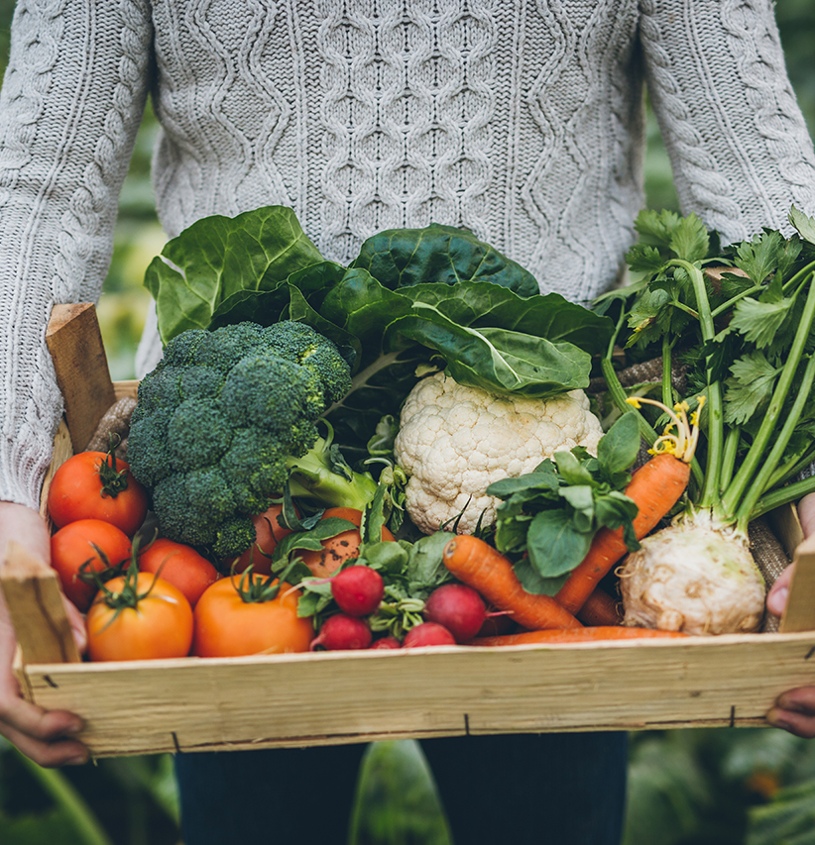
Heal the Gut
Avoid Common Food Allergens
Focus on lightly steamed vegetables, fruits, fish, or organic meats
Plenty of Fresh Water
Avoid Processed Foods / Processed Sugars
Probiotics, Glutamine, Slippery Elm, or DGL may be helpful
*Speak with your Health Care Practitioner about appropriate interventions

Slide 10
Adequate Fiber
Soluble Fiber Sources | Insoluble Fiber Sources
Fruit with peel | Wheat bran
Oats | Corn bran
Barley | Whole grain breads
Legumes / Beans | Whole grain cereals
Nuts | Vegetables
Recommended Fiber Intake Varies depending on Source: Average is 25-35 grams for most adults
Two types of fiber: Soluble and Insoluble

Slide 11
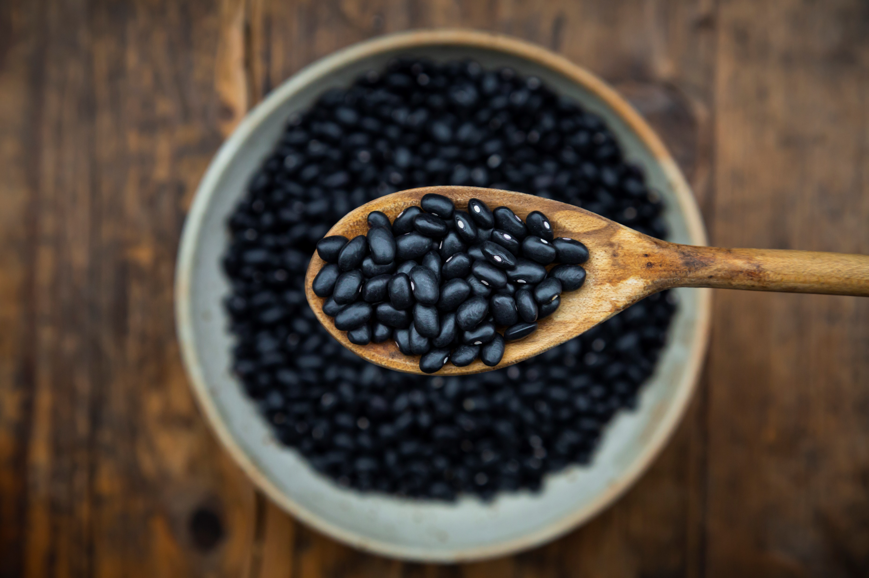
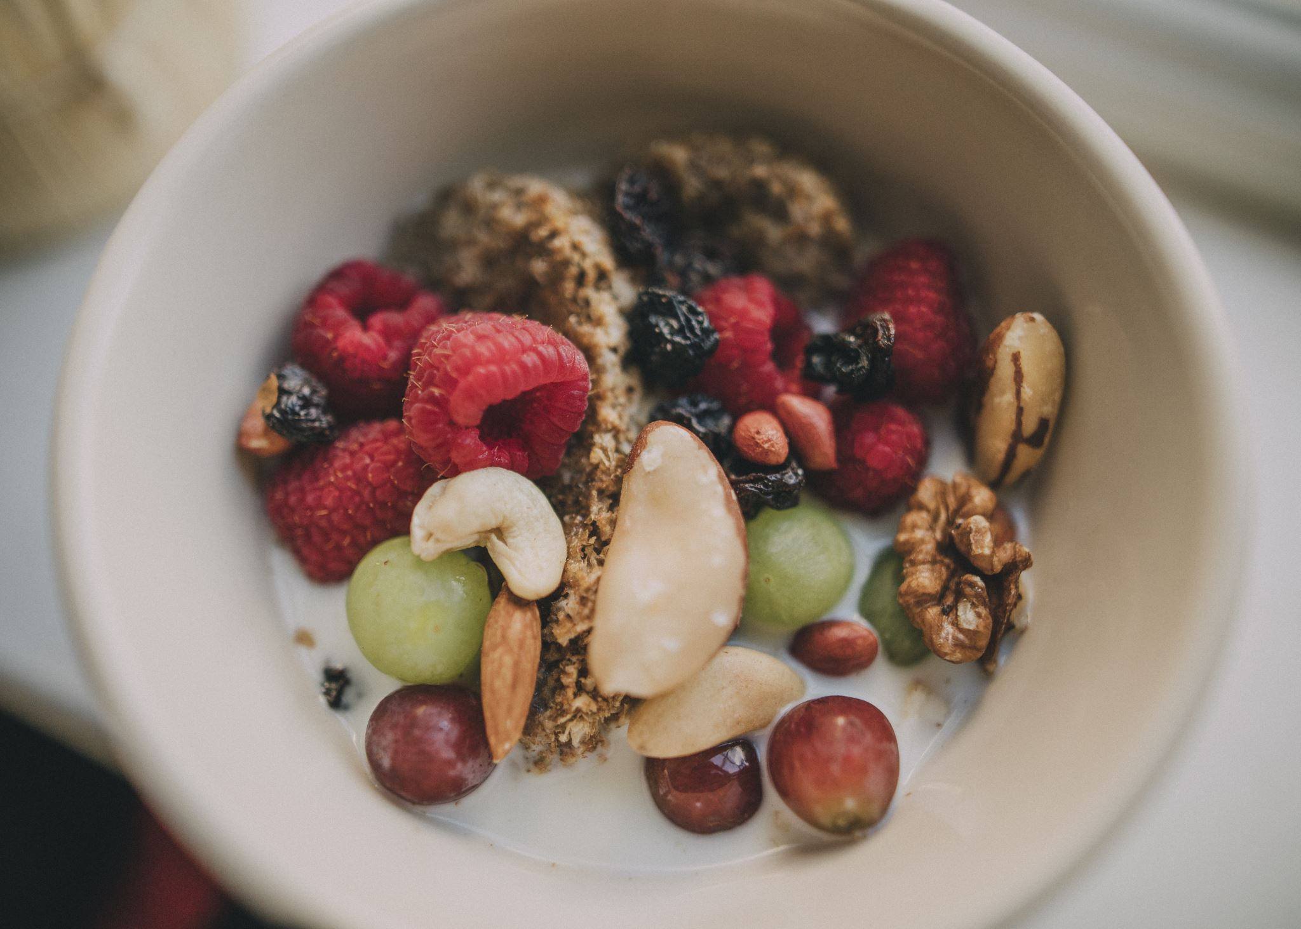
Soluble Fiber Functions | Insoluble Fiber Functions
Lowers total cholesterol / LDL cholesterol | Helps move waste along digestive trace, preventing constipation
Lowers triglycerides | Controlling Intestinal pH
Contributes to full feeling | Helping prevention of colon cancer
Reduces blood sugar, by slowing absorption

Slide 12
Common Food Allergens
Wheat / Gluten
Dairy
Corn
Soy
Eggs
Citrus Fruits
Food Additives
Nightshade Family

Slide 13
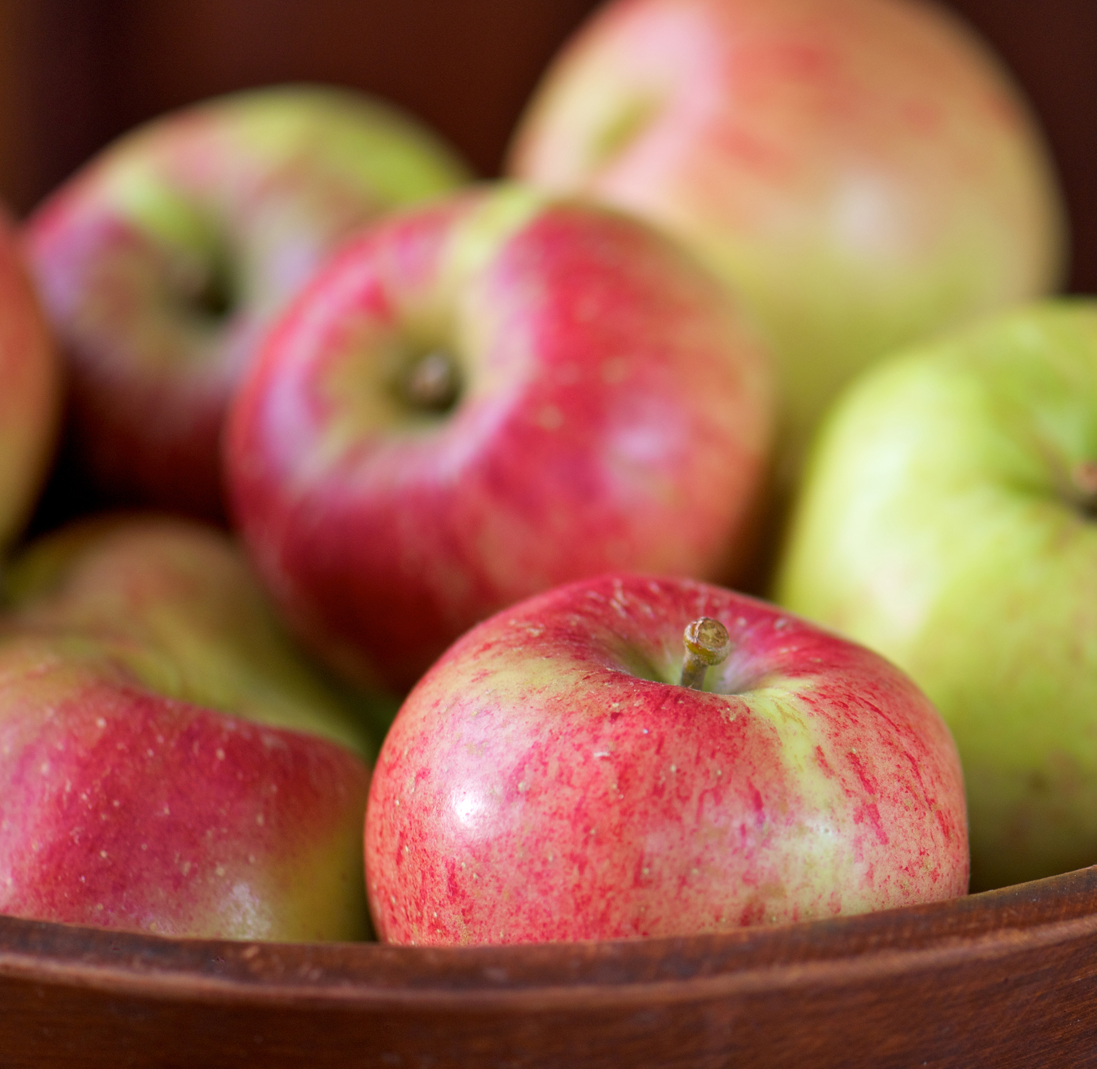
Elimination Diet
Consider an Elimination Diet of Common Allergens for 2 weeks
Talk to your Health Care Professional about how to do so safely within your independent medical needs
Reintroduction phase is critical to a good elimination diet
Journaling the process or taking notes is also helpful

Slide 14
Common Symptoms of Food Allergies
Skin: eczema, dermatitis, itching, hives, swelling, redness, acne, dark circles under eyes
Gastrointestinal: diarrhea, gas, nausea / vomiting, cramps, bloating, abdominal pain, constipation
Respiratory: wheezing, nasal congestion, trouble breathing, asthma
Other: joint pain, swelling (lips, tongue, face, throat), headache, migraines, brain fog, fatigue

Slide 15
Sugar Woes
Addiction – Affects opioids and dopamine in brain (peaks and troughs)
Endorphin activation (similar to heroin / morphine)
US Annual consumption average: Around 60 pounds of added sugar per year
Candy, soda, fruit juices, junk food, crackers, peanut butter, coffee drinks and even canned soup
Too many calories → obesity risk / depression / B vitamin depletion

Slide 16
Identify and Eliminate Stress Triggers
Consider working with doctor or counselor to identify triggers for stress and work on healthy management techniques
Meditation and exercises such as Yoga, Tai chi, walking are all helpful to bring down stress and benefit an overall feeling of well-being.

Slide 17
Depression and Disease
“Depression produces the greatest decrement in health compared with the chronic diseases angina, asthma, and diabetes. The comorbid state of depression incrementally worsens health compared with depression incrementally worsens health compared with depression alone, with any of the chronic diseases alone, and with any combination of chronic diseases without depression.” – The Lancet (2007)

Slide 18
Depression Triggers
Chronic Stress (Job, Family, Financial)
World Affairs
Inadequate Exercise
Diabetes, Cardiovascular Disease, Cancer
Anemia
B12 Deficiency (B Vitamin Deficiency)
Vitamin D Deficiency
Insomnia, poor sleep
Digestive diseases

Slide 19
Probiotics and Anxiety
Probiotics shown to help with healthy Serotonin production in the gut. 90% of total serotonin located in the enterochromaffin cells in the gut
“Lactobacillus (L.) rhamnosus has the most evidence showing that it could significantly reduce anxiety.” – Psychology Today (2018)
Retrieved 12/28/22 from: https://www.psychologytoday.com/us/blog/urban-survival/201809/can-probiotics-help-reduce-anxiety

Slide 20
Exercise and Health
Morning exercise leads to better sleep, healthier appetite, boost of endorphins
Increases self-confidence, lowers the symptoms of depression and anxiety
Eastern Medicine: Decreases Qi Stagnation in the Channels
Recommended Goal Setting
Consider a Pedometer or Fitbit

Slide 21
The Importance of Sleep
Sleep necessary for cellular regeneration
Increased secretion of growth hormone during sleep. Growth hormone thought to have a “rejuvenation” effect
“Sleep functions as an antioxidant for the brain as free radicals are removed during this time.”
– Pizzorno & Murray, Textbook of Natural Medicine, 3rd Edition

Slide 22
Sleep Hygiene: Bedroom as Oasis
Ideally, the bedroom should be quiet (exception: white noise), free from clutter, free from light
Place of sleep, not work
Avoid TV / Computer / Phones in the bedroom
Avoid watching news or distressing programs before bed
May need to relocate pets / snoring partners
You may spend 1/3rd of your life in sleep – keep the bedroom clean of dust and debris – most important room in the house

Slide 23
Routes of Clearance
Skin – Sweating, skin brushing, hydrotherapy, dead sea salt baths
Bowels – Adequate fiber, diversity of whole foods, probiotics
Lungs – Fresh air, deep breathing / meditation
Urinary – Fresh water, healthy cardiovascular function
Liver – Decrease or eliminate alcohol, watch for medications that can affect the liver (Tylenol), decrease toxin exposure (organics as able)

Slide 24
Can Supplements Help?
Supplements cannot replace healthy lifestyle decisions including healthy foods, exercise, sleep, or other forms of nourishment, such as healthy relationships and community
Supplements can assist in recovery within those areas in moderation
Supplement quality varies considerably
Talk with your Doctor or Health Care Provider about their recommendations

