Slide 1
Avoiding Acid Reflux / GERD
Dr. Melanie Trowbridge, ND, Lac
This presentation is not meant to diagnose, treat, or offer medical advice.
For education purposes only.

Slide 2
What is Acid Reflux / GERD
Gastroesophageal Reflux Disease (Acid Reflux or Reflux Esophagitis)
AKA: Heartburn
Reflux: Flowing back in a system
When stomach acid is passed into the esophagus

Slide 3
Lower Esophageal Sphincter (LES)
Keeps stomach contents from flowing upwards into the esophagus
Some gastroesophageal reflux is normal physiology
Becomes a disease with macroscopic damage or causes symptoms

Slide 4
Gastric Acid – Important to Digestion
Gastric Acid: pH of 1 to 2
Digestion of proteins: Activates digestive enzymes → Breakdown to Amino Acids
Prevents infection from bacteria on food (Greater risk of H. Pylori infection with hypochlorhydria)
Assists in the release of vitamin B12 from proteins
Hypochlorhydria can lead to osteoporosis, B12 deficiency, or infection

Slide 5
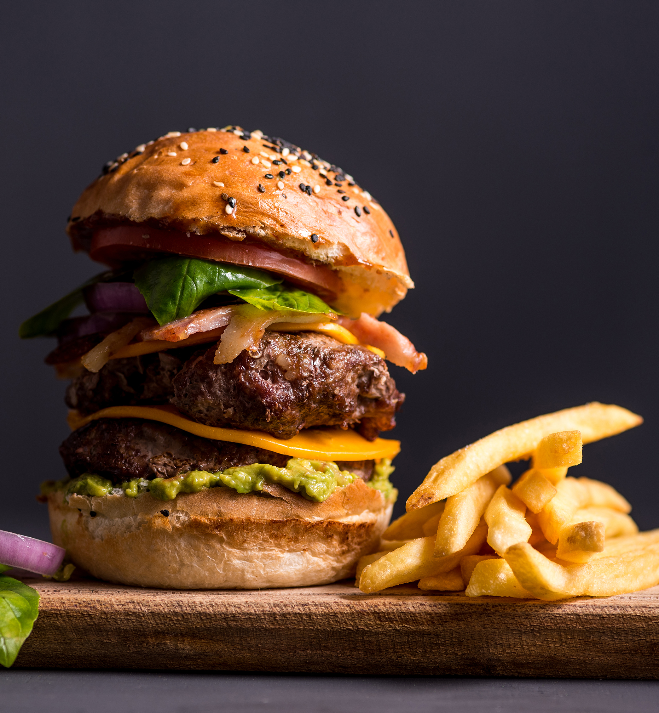
Potential Symptoms of GERD
Heartburn occurring after meals
Worse bending over / lying down
Pain relieved by antacids
Cough / Regurgitation
Regurgitation of stomach acid into mouth

Slide 6
Potential Symptoms of GERD cont.
Indigestion / Nausea
Sour taste in the mouth
Epigastric pain
Early satiety: Feeling full early on in meals
Belching

Slide 7
Potential Symptoms of GERD cont.
Globus sensation (lump in throat)
Hypersalivation
Odynophagia (Pain on swallowing food)
Bad Breath

Slide 8
Other Possible Symptoms
Wheezing
Nocturnal Cough
Nocturnal Choking
Hoarseness
Noncardiac chest pain
Enamel Erosion

Slide 9
Why does GERD occur?
One theory: Inappropriate relaxation of the Lower Esophageal Sphincter (LES)
Like blowing up a balloon and then relaxing – changing the gradient

Slide 10
Contributing Factors
Obesity
Pregnancy
Hiatal Hernia
Diabetes
Connective Tissue Disorders
Drugs: NSAIDS, Opioids, Anticholinergics, Tricyclic Antidepressants
Note – Never discontinue a medication without first consulting the prescribing doctor

Slide 11
Foods That Often Worsen GERD
Chocolate
Caffeine (Coffee / Tea)
Alcohol
Tomato juice
Chocolate
Cow’s milk
Peppermint
Fatty or Fried Foods
Gluten or other allergens
Other substances

Slide 12
Common Standard Treatments
Weight Loss
Elevation of the head of the bed
Elimination of dietary triggers
Antacids
H2 Receptor Antagonists
Proton-pump Inhibitors

Slide 13
Common Natural Treatments – Eating Hygiene
Eating in a relaxed environment
Eating smaller meals (70-80% full)
Chewing foods more thoroughly
Not eating close to bedtime
Not laying down after eating

Slide 14
Common Natural Treatments – Demulcents / Herbals
Demulcents form a protective barrier and may help in alleviating symptoms
Ulmus fulva (slippery elm)
Althea officinalis (marshmallow root)
Matricaria recutita (German chamomile)
DGL – DeGlycyrrhinated Licorice

Slide 15
Common Natural Treatments – Elimination Diets
Some people may find that they are reactive to certain foods or have “food allergies” that result in GERD symptoms
Some common food allergens include:
Dairy
Wheat / Gluten
Corn
Soy

Slide 16
Acupuncture and Eastern Medicines
Associated with the Liver and Stomach in Chinese Medicine
Liver Controls the energy of the stomach, when the stomach’s energy is in excess → GERD
Liver is associated with anger, stress, frustration
In excess, this leads to liver energy rising and flowing outward → reverse of stomach’s energy
Stomach energy naturally flows downward, but reverses in these conditions

Slide 17
Acupuncture
Acupuncture has been found useful by many for the relief of heartburn symptoms and severity
Chinese herbal formulas are decocted for harmonizing the liver / stomach function

Slide 18
Summary
Do not ignore symptoms of GERD / heartburn
Complications may include esophageal stricture, ulceration, Barrett’s esophagus and esophageal carcinoma
See your doctor to find out what tests are necessary for diagnosis and treatment
Consider acupuncture of herbal therapies for helping relieve the underlying cause or alleviation of symptoms

