Slide 1
Water and Flow
Dr. Melanie Trowbridge, ND, LAc
Foundations Natural Health
This presentation is not meant to diagnose, treat, or offer medical advice.
For education purposes only.

Slide 2
What We Are
We are mostly space in between molecules that are solidly comprised mostly of water (60-70%)
Water is 75% of a Newborn’s weight
No life exists without it

Slide 3
We are Oceans
Our hormones are related to the Sun and the Moon – Vitamin D synthesis / Melatonin and others.
Circadian rhythms regulated by our hypothalamus, pineal gland
Minerals and trace minerals in water are important for certain body processes, such as calcium, magnesium – bone, blood pressure.
Unfortunately, we end up contaminating with heavy metals, plastics, chemicals.

Slide 4
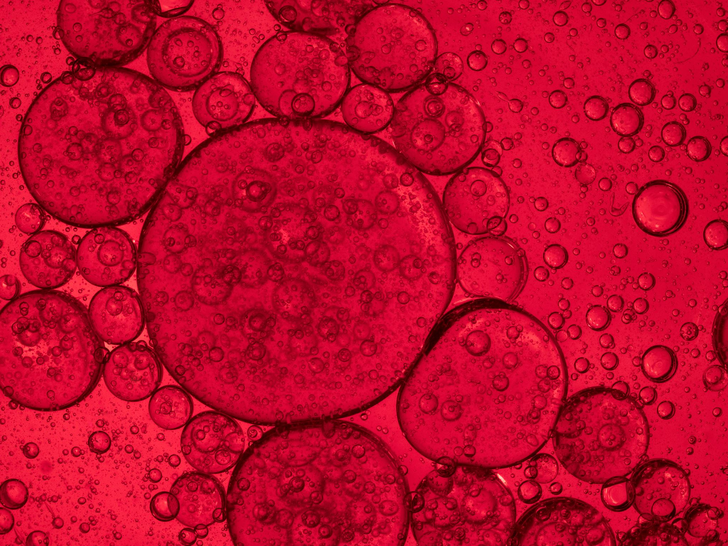
Water – Make it Clean
Clean water is a topic of concern in many nations including our own.
Many minority and low-income communities are facing no water crises.
Chemicals or fossil fuel spills easily leach into ground water supplies and into drinking water.

Slide 5
Reasons for Dehydration in Some
Lack of Clean Water or Thirst
Medications
Increased Urination
Illness, Diarrhea, or Vomiting
Incontinence & Avoidance of Drinking
Dementia
Uncontrolled Diabetes
…and More

Slide 6
Signs of Dehydration
Fever, Headache, or Confusion
Lips cracked / dry
Skin dry / “tenting”
Low Blood Pressure
Urine dark, smells strong
Fast Pulse

Slide 7
Complications of Dehydration
Kidney Failure
Coma
Shock
Heat-related illnesses
Electrolyte imbalances (Sodium, potassium, chloride) → Heart rhythm abnormalities

Slide 8
Water Loss
10% loss of body water → Hallucinations
20-25% loss → Death
Can not survive more than a few days without water
We lose water through urination, defecation, respiration, evaporation
Kidney is primary organ responsible for water management

Slide 9
Kidney Failure – Water Restriction
Kidney is the primary organ to process water loss
As kidney filters less successfully, fluid overload occurs
Function of the heart and lungs decline
Ask your doctor for recommended amount

Slide 10
How Much – General Guidelines
Good Health can drink when thirsty
Varies with activity level, health & environment
No single formula fits everyone
About 3.7 liters of fluids a day for men
About 2.7 liters of fluids a day for women
According to: Mayo Clinic & U.S. National Academies of Sciences, Engineering, and Medicine

Slide 11
What does Water do for us?
Body Temperature Regulation
Moistens tissues including eyes, nose, mouth
Joint lubrication
Protects body organs / tissues
Constipation prevention
Flushes out waste products → Helps with Liver and Kidney Function

Slide 12
What else does Water do for us?
Transports minerals, nutrients to all areas of the body
Transports nutrients and oxygen to the cells

Slide 13
Water and Colon Health
Water is reabsorbed in the colon
Constipation is likely with poor water intake
Constipation can lead to increased re-uptake of certain substances (toxins, bile, cholesterol, hormones)
Constipation can also lead to increased risk of diverticulitis and decreased colon health

Slide 14
Coffee & Tea?
Most Herbal Teas do not contain caffeine and therefore won’t keep you up at night
Coffee and Black / Oolong / Green / White Teas, Cola – All contain caffeine and act as a diuretic – Avoid in excess
Excess for most is more than 1-2 cups / day, but varies broadly

Slide 15
Favorite Herbal Teas
Peppermint – Soothing & Calming (Careful in those with heartburn)
Nettle Leaf – Mineral rich, gentle diuretic
Roobios Tea – High antioxidant, helpful to nervous & digestive systems
Chamomile – Used to stimulate digestion, Gentle Nervine

Slide 16
Ideas for Increasing Water Intake
Add a squeeze of lemon or diluted Apple Cider Vinegar
Visit herbalist for finding the right herb for you
Add a little juice (tart cherry, cranberry, orange) to water – Importance of dilution of juices due to high sugar content in many
Replace excess coffee for Dandelion or Mushroom teas

Slide 17
Temperature & Water
According to Eastern Medical theory –
Water should be consumed cool to warm
Those with sensitivities in digestion or in depleted states should drink room temperature to warm
Ice in water is not recommended, especially in the middle of winter

Slide 18
More Resources
https://www.mayoclinic.org/healthy-lifestyle/nutrition-and-healthy-eating/in-depth/water/art-20044256
https://www.health.harvard.edu/staying-healthy/how-much-water-should-you-drink

