Slide 1
Organic Gardening
Naturopathic Techniques for Productive Earth
Dr. Melanie Trowbridge, ND, Lac
This presentation is not meant to diagnose, treat, or offer medical advice.
For education purposes only.

Slide 2
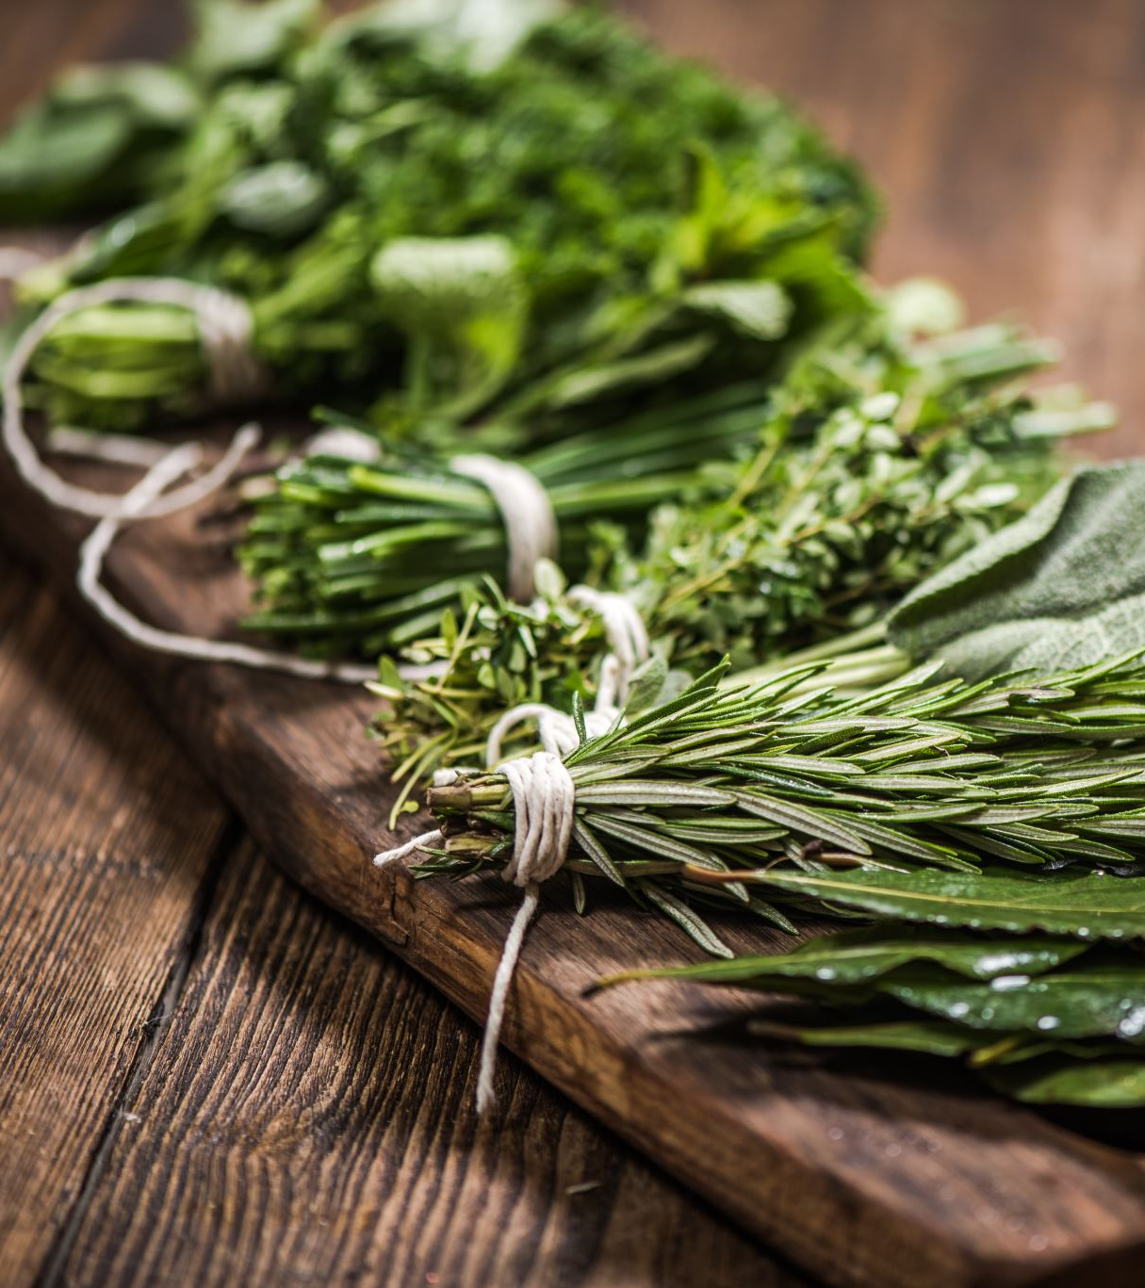
Why Garden?
Play as Medicine!
Exercise
Relaxation / Health
Food
Nature
Socialization
Beauty / Art

Slide 3
Goals for organic gardening
Make the land less toxic to life, not more
01
Find approaches to bring fertility to your soil
02
Encourage natural populations of bugs to ward off pest overrun
03
Stick with natives and non-invasive plants
04
Encourage the natural environment where applicable
05

Slide 4
Use less toxins – Some questions
Where do most fertilizers come from?
What do insecticides do to the land?
When is GMO useful vs. harmful?
Ways to supplement the soil naturally?
How do we use biodiversity to promote healthy insect populations?
What are some non-toxic solutions to pest problems?

Slide 5
Soil fertility
Feed the soil in the same way that you would feed yourself – with diversity!
You wouldn’t survive without diverse foods such as fruits, vegetables, proteins, carbs, and fats
In the same way your garden needs diversity.

Slide 6
Important soil nutrients
Plants need at least seventeen elements to grow. Plants have carbon, oxygen, and hydrogen from air and water; but they still need nitrogen, potassium, & phosphorus.

Slide 7
Decomposing material
Nitrogen → Chlorophyll, cell walls
Coffee grounds, table scraps, lawn & garden weeds contain Nitrogen
Leguminous plants play an important role in nitrogen fixation – alfalfa, clover
Gas Nitrogen made usable by leguminous plants and microbial populations

Slide 8
Basic composting
Determine what is Nitrogen / what is Carbon
A Basic rule is browns for Carbon, Greens for Nitrogen
Remember you are looking for a 25-30:1 Carbon to Nitrogen Ratio.
If the ratio goes too much Carbon, you get a pile that won’t compost.
Too high Nitrogen is stinky and sloppy

Slide 9
Soil Composition
Soil is composed of 3 ingredients: Sand, Clay, Loam
If soil is too sandy – won’t hold water
Too much clay – drains poorly
Loam is a mix of sand, clay, organic matter – well-drained, able to store moisture and nutrients
Proposed Project: Check your soil composition

Slide 10
Microbes in the garden
The healthier the microbe population, the faster and more efficient the breakdown of materials into usable nutrients in plants
(Not much unlike the role of gut bacteria in the human gut)

Slide 11
Pest and animal control
Fencing / motion lights are helpful to deter some wild creatures from eating the garden.
Slugs are hard to take care of naturally
A pan of beer to kill / thin the herd
Copper must be thick strip to deter
Consider essential oils as higher force interventions
Chickens eat some, but rarely. Ducks like to eat slugs, but require ponds and more care

Slide 12
Other pest control tips
Ladybugs love to eat aphids
Encourage garden spiders to thrive
Keep desired crop elevated off the ground in possible
Bats also helpful for preventing bug overpopulation
Insecticides kill off the weak but encourage bullies

Slide 13
Speaking of bullies - invasives
English Ivy
Best removal techniques – Gloves, hands and knees
Himalayan Blackberries
Best removal techniques – Weed-wack to roots several times, cover with thick mulch, uncover, weed-wack, repeat
Thick gloves, sturdy clippers, and removing the root ball

Slide 14
Native plants that thrive
Oregon Grape – Ornamental with yellow berries
Wild Strawberry – Great for hill covers
Oxalis / Redwood Sorrel (somewhat native) – beautiful cover around Evergreen trees
Rhododendrons – Good foliage for privacy. Beautiful flowers in the spring

Slide 15
More native plants that thrive
Nootka Rose – Delicate natural looking rose blooms. Hardy, loves to expand up and out.
Great places to find Natives Plants include Native Plant Society sales or smaller nurseries around the area such as Molbak’s in Woodinville

Slide 16
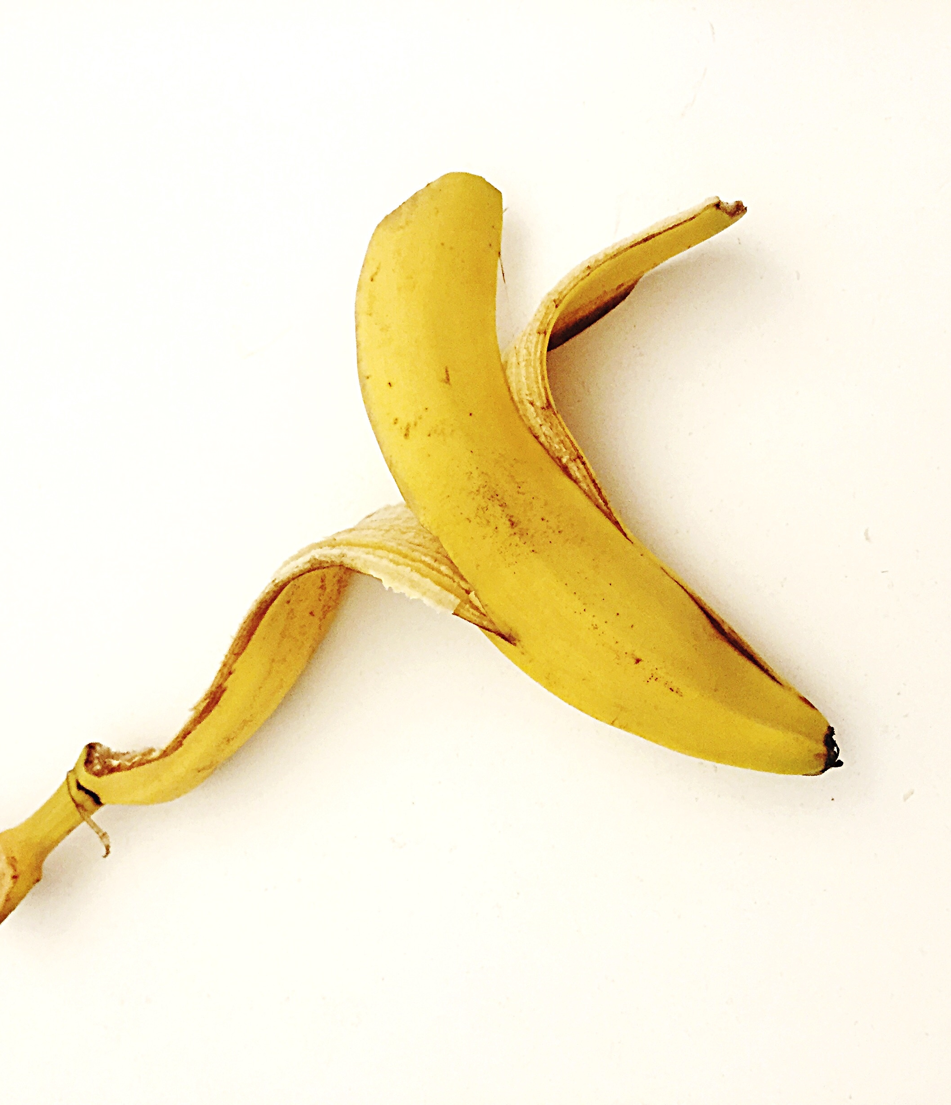
Vermiculture
Great for quick composting and ready to use nutrient-rich soil
Usually Red Wigglers (sometimes Earth worms)
Almost any adapted container can be used
Bins need holes
Temperature between 59-77 degrees F preferable

Slide 17
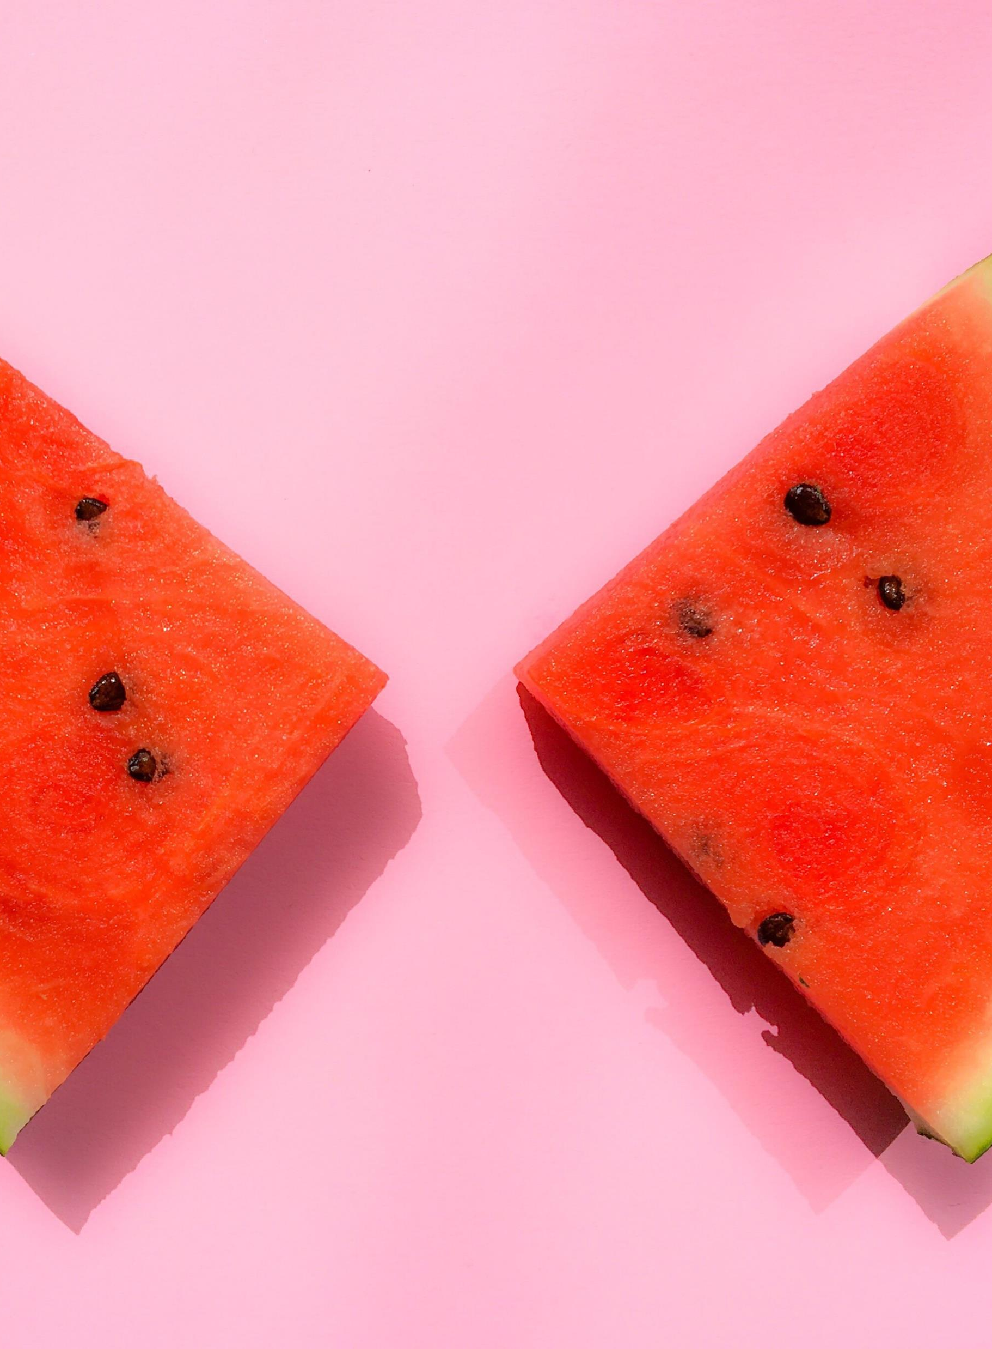
Vermiculture cont.
Should be checked on regularly
Meat, dairy products are likely to smell bad, rot vs. get broken down into compost
Vermicompost capable of being mixed directly into the soil or seeped in water for “worm tea”
Concerns may include: Smell, moisture, pests, worms escaping, nutrient levels

Slide 18
Vermiculture cont.
Where to get worms:
Avoid using worms from the garden – most garden earthworms like to burrow deeply and are kept at lower temperatures than red wigglers
Red Wigglers found at worms.com (mail), Seattle Tilth, or through other persons practicing vermiculture

Slide 19
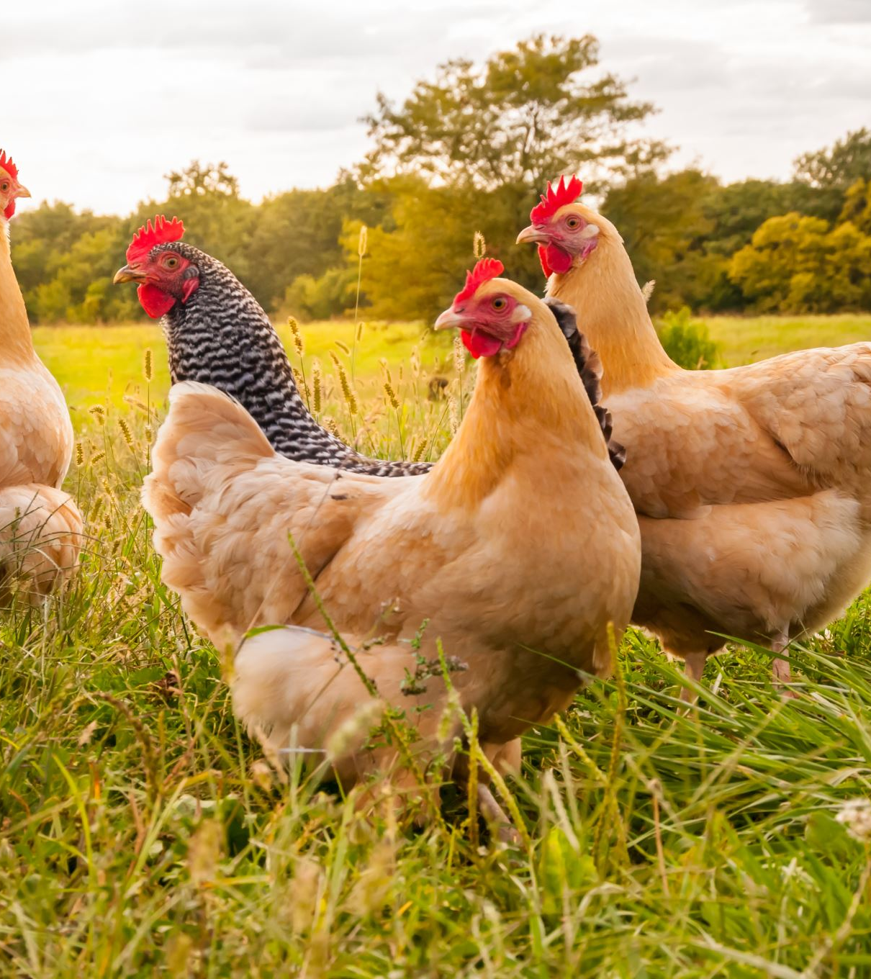
Backyard chickens
Major Commitment! – Very enjoyable for some
Require space and kind neighbors
Pets or Farm Animals? Older chickens stop laying eggs
Chickens make you laugh
Benefits of eggs, fertilizer, fun
…but can also be a very complicated outdoor pet

Slide 20
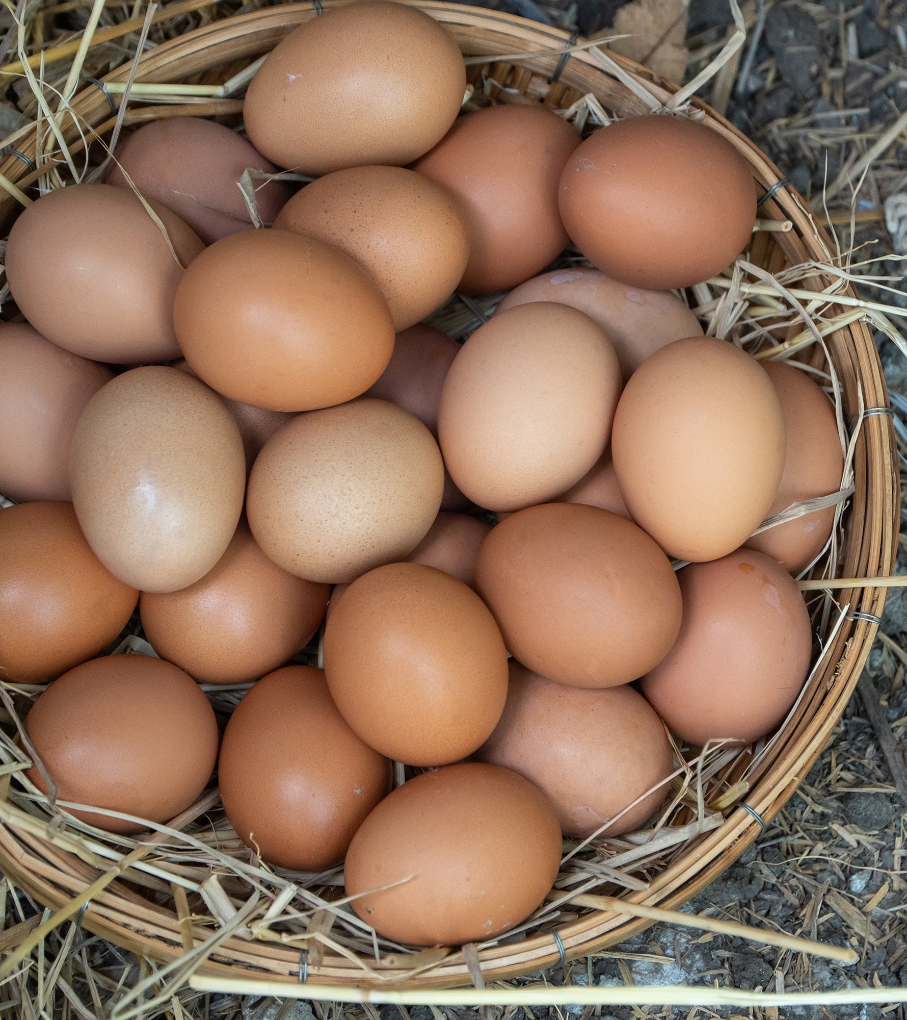
Backyard chickens Cont.
Choosing chicken breeds
Sound is a BIG factor in chicken selection
Do you want a rooster?
Is a rooster legal in your area?
What would you do if your chick was a rooster?
Plan for baby chicks the first day

Slide 21
Recommended Resources
Naturopathic Gardening – Jenn Dazey – Available through the Bastyr Bookstore
Seattle Tilth – Nonprofit local Seattle Organization dedicated to helping others understand organic gardening techniques
Washington Native Plant Society

Slide 22
Recommended Resources cont.
The Garden Hotline – (206) 633-0224
Seattle Public Utilities offers pamphlets on Growing Healthy Soil, Natural Lawn Care, Growing Food in the City, Get to Know your Soil
Master Gardener Program through King County - WSU

