Slide 1
The Importance of Whole Foods
Dr. Melanie Trowbridge, ND, LAc
This presentation is not meant to diagnose, treat, or offer medical advice.
For education purposes only.

Slide 2
What is a Whole Food?
Something you can imagine growing in Nature
Food that is unprocessed or left in its whole form

Slide 3
Foods vs. Supplements
Research shows to get the health benefits from some of our top “superfoods”, you need to consume the whole food and not a supplement containing its constituents
Synergistic activity?
Studies show that supplements don’t extend life and may actually shorten life in some instances. Food is the medicine.

Slide 5
Making Changes in Diet Work
Start Slow: Focus on change that is reasonable for your lifestyle.
Plan Ahead: Don’t wait until you are tired and hungry to prepare
Give Yourself a Goal: Understand what you are trying to achieve and how your dietary changes can help

Slide 6
Quick and Easy Breakfast
Healthy Recipes for those on the go

Slide 7
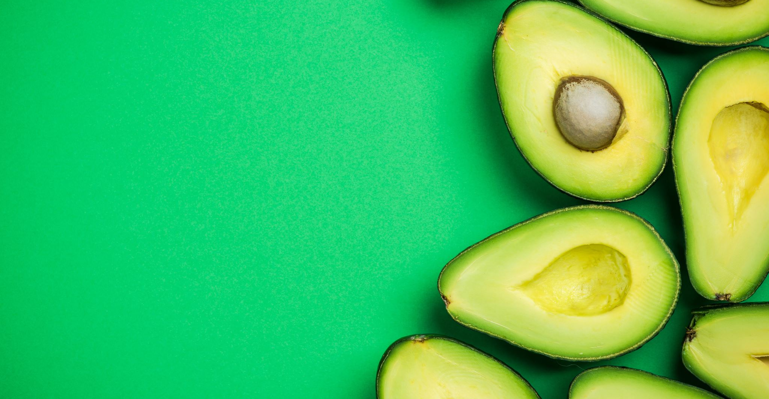
Breakfast Burrito Benefits
Ingredients can be prepared in advance
Eggs provide a good source of low-calorie protein (6g)
Whole grain or sprouted grain tortilla + vegetables and avocado are a good source of dietary fiber
Dietary fiber has been shown to help with weight loss and reduce the risk of developing type II diabetes

Slide 8
Eggs and Cholesterol
Fact: Eggs are higher in cholesterol than many foods – average about 200 mg / large egg
Myth: Eating an egg a day has been showing to significantly raise cholesterol
Summary: Most research studies show little to no increase in blood levels of cholesterol for those eating an egg a day and no increase in heart disease risk.
Source: https://www.hsph.harvard.edu/nutritionsource/food-features/eggs/

Slide 9
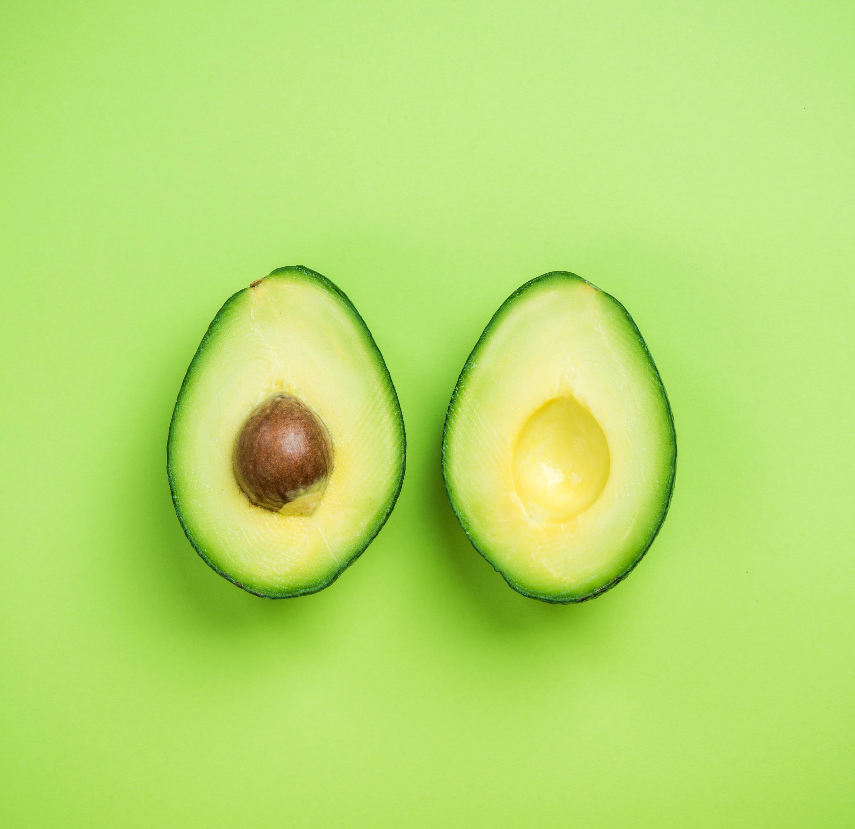
Avocados and Fat
Fact: A medium size avocado contains around 30 grams of fat
Myth: Moderately consuming avocados will lead to weight gain
Summary: Avocados are highest in monounsaturated fats, the kind that is known to lower cholesterol. Avocados are also packed with vitamins, minerals, and phytonutrients to promote health.

Slide 10
Breakfast Burrito Shopping List
Whole Grain Tortilla
Organic Free-Range Omega-3 Eggs
1 medium avocado (slightly soft)
Zucchini or yellow squash
1 medium onion
Olive oil
Broccoli
Lettuce of choice
Glass jar of Salsa
Modify to avoid known food allergens
Talk to your doctor if you have dietary restrictions

Slide 11
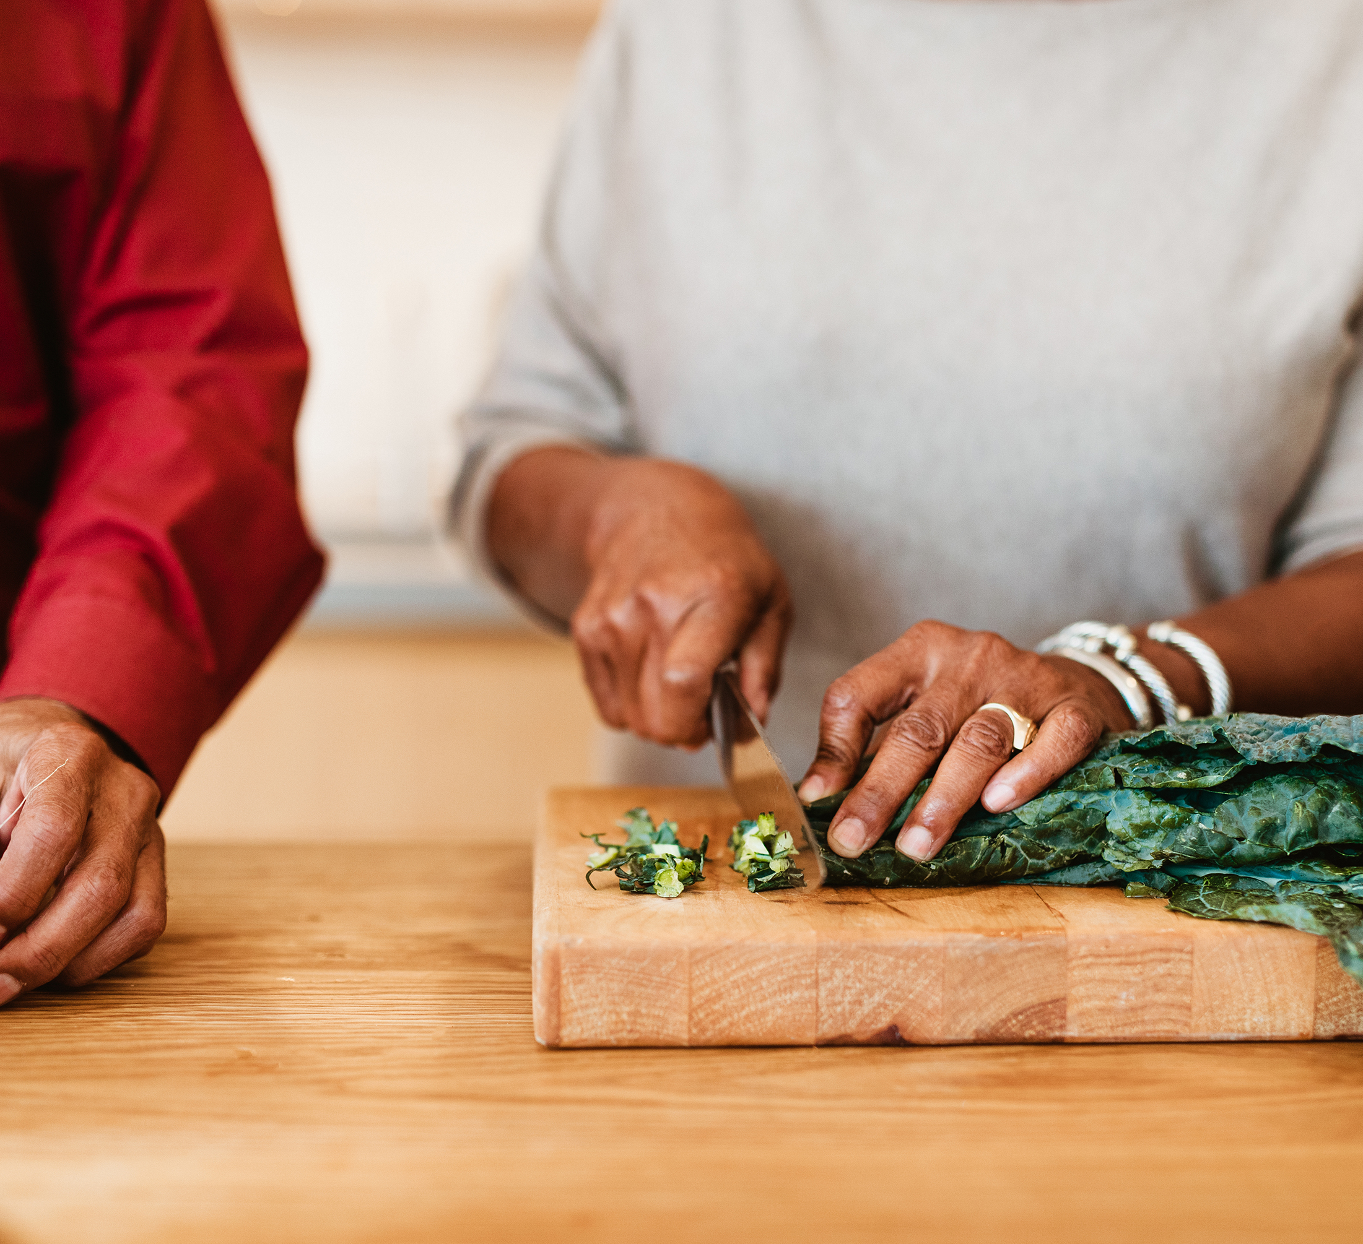
In Advance
Dice Onion, chop broccoli, squash
Lightly sauté onions, squash, broccoli together over low heat – just enough to soften a bit
Store in glass Pyrex
Rinse and cut lettuce into strips
Hard boil egg

Slide 12
In the Morning
Lay out tortilla (warm in pan on low heat if needed)
Spread avocado onto tortilla
Cover with lettuce pieces
Peel and chop egg, add to tortilla
Add onion, squash, broccoli mix
Add a scoop of salsa and spread
Roll tortilla and enjoy

Slide 13
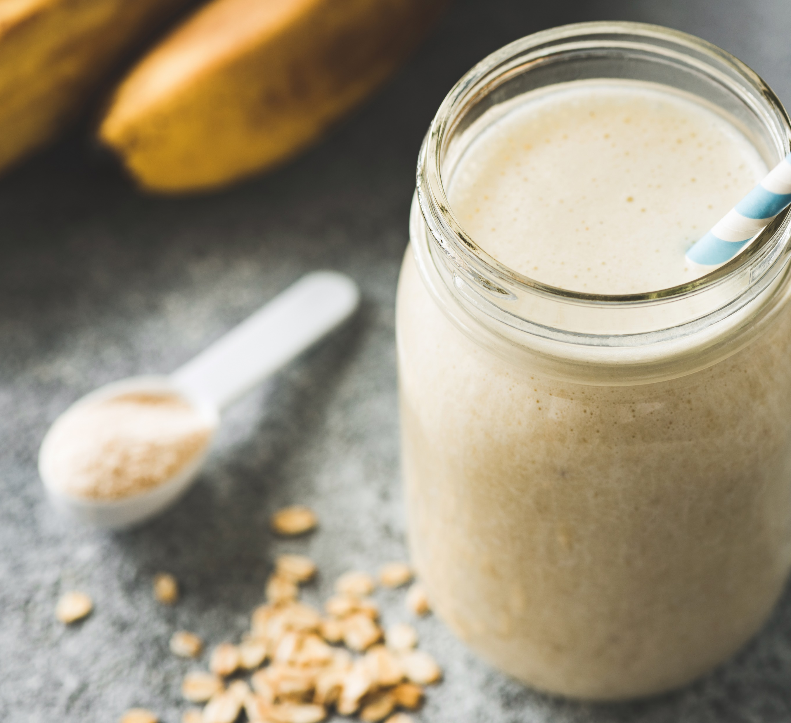
Breakfast Smoothie
For those on the go, smoothies offer a protein packed meal that will help stave off hunger until lunchtime or mid-morning snack.
The Basic Smoothie
1 Banana
1 cup frozen fruit
8 oz. milk of choice (oat is one alternative)

Slide 14
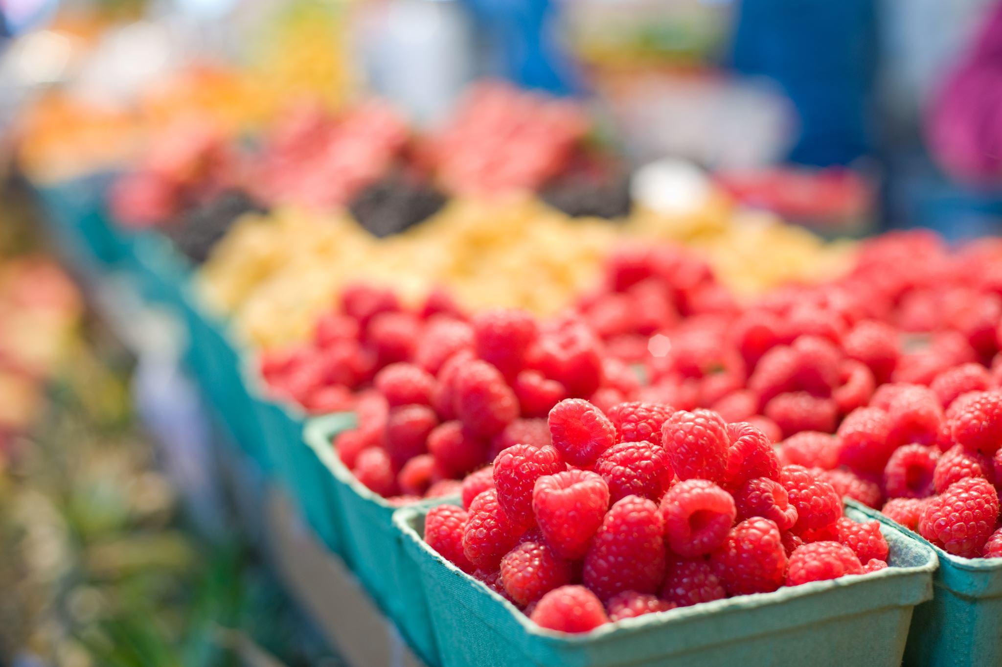
Smoothie Additions
Fiber
Oats
Whole Grains
Fruits
Vegetables
Ground Flax Seeds
Psyllium husk powder
Protein
Yogurt
Kefir (fermented milk)
Tofu
Nut butters
Bee pollen
Nutritional Yeast
Spirulina
Protein Powder

Slide 15
Smoothie Additions Cont.
Organic Pure Moringa Vegetable Powder – Green Superfood – Raw – Vegan – Good Source of Calcium, Iron, & Fiber
Organic Siberian Chaga Mushroom Powder Extract – Historically, known to Boost Immunity & Overall Health
Organic Pea Protein Powder

Slide 16
Lunch and Dinner
Savory meals to balance blood sugar and provide sustained energy

Slide 17
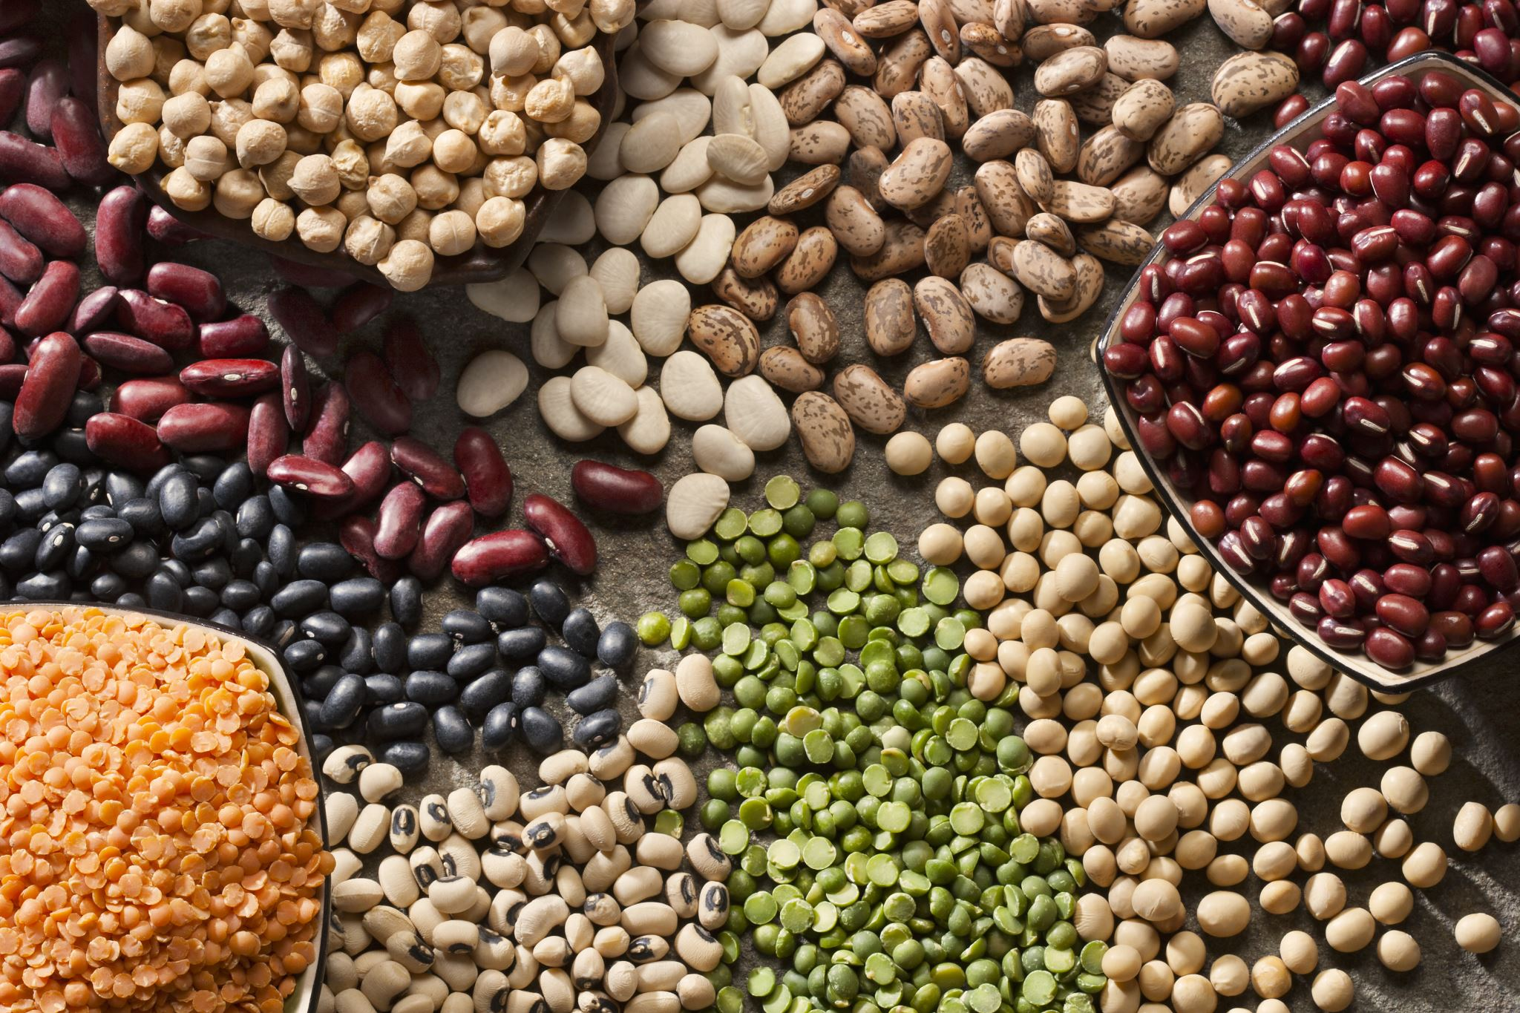
The Importance of Protein
Protein in balancing blood sugar
Diets higher in protein, moderate in carbohydrates help with weight loss
Good source of protein will help you feel fuller and satisfied longer than a high carbohydrate meal
Healthiest Sources of Protein: Fish, Eggs, Poultry, and Beans

Slide 18
Healthy Start: Green Leafy Salad
The USDA recommends that we eat at least 3 cups of dark green vegetables per week (Swiss Chard, Kale, or Collards)
The benefits include:
Most concentrated sources of vitamins (K, E, C, Bs)
Rich source of minerals (iron, calcium, potassium, magnesium)
Phytonutrients (Beta – Carotene, lutein, zeaxanthine

Slide 19
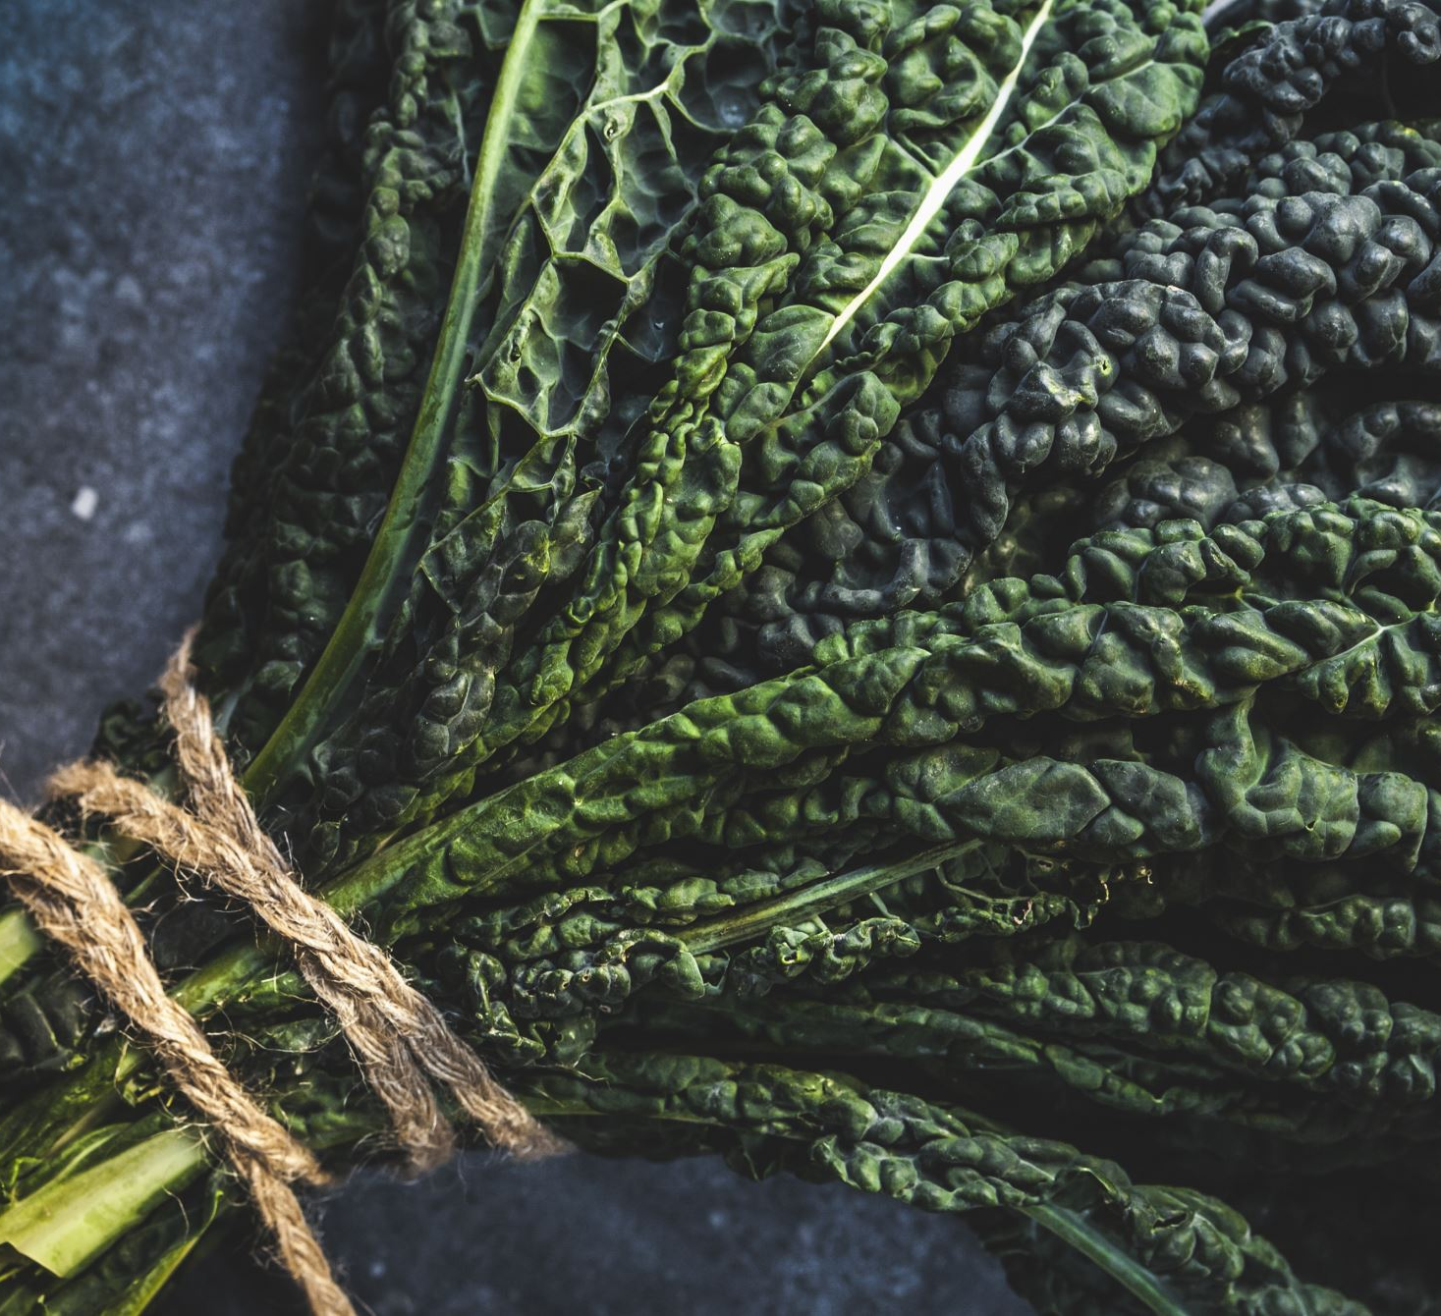
Green Leafy Salad: Adapted from PCC’s Emerald City Salad
1 cup uncooked wild rice
½ cup olive oil
½ cup lemon juice
1 tsp minced garlic
1 tsp salt
½ tsp black pepper
2 cups finely chopped dark leafy greens
Continued …

Slide 20
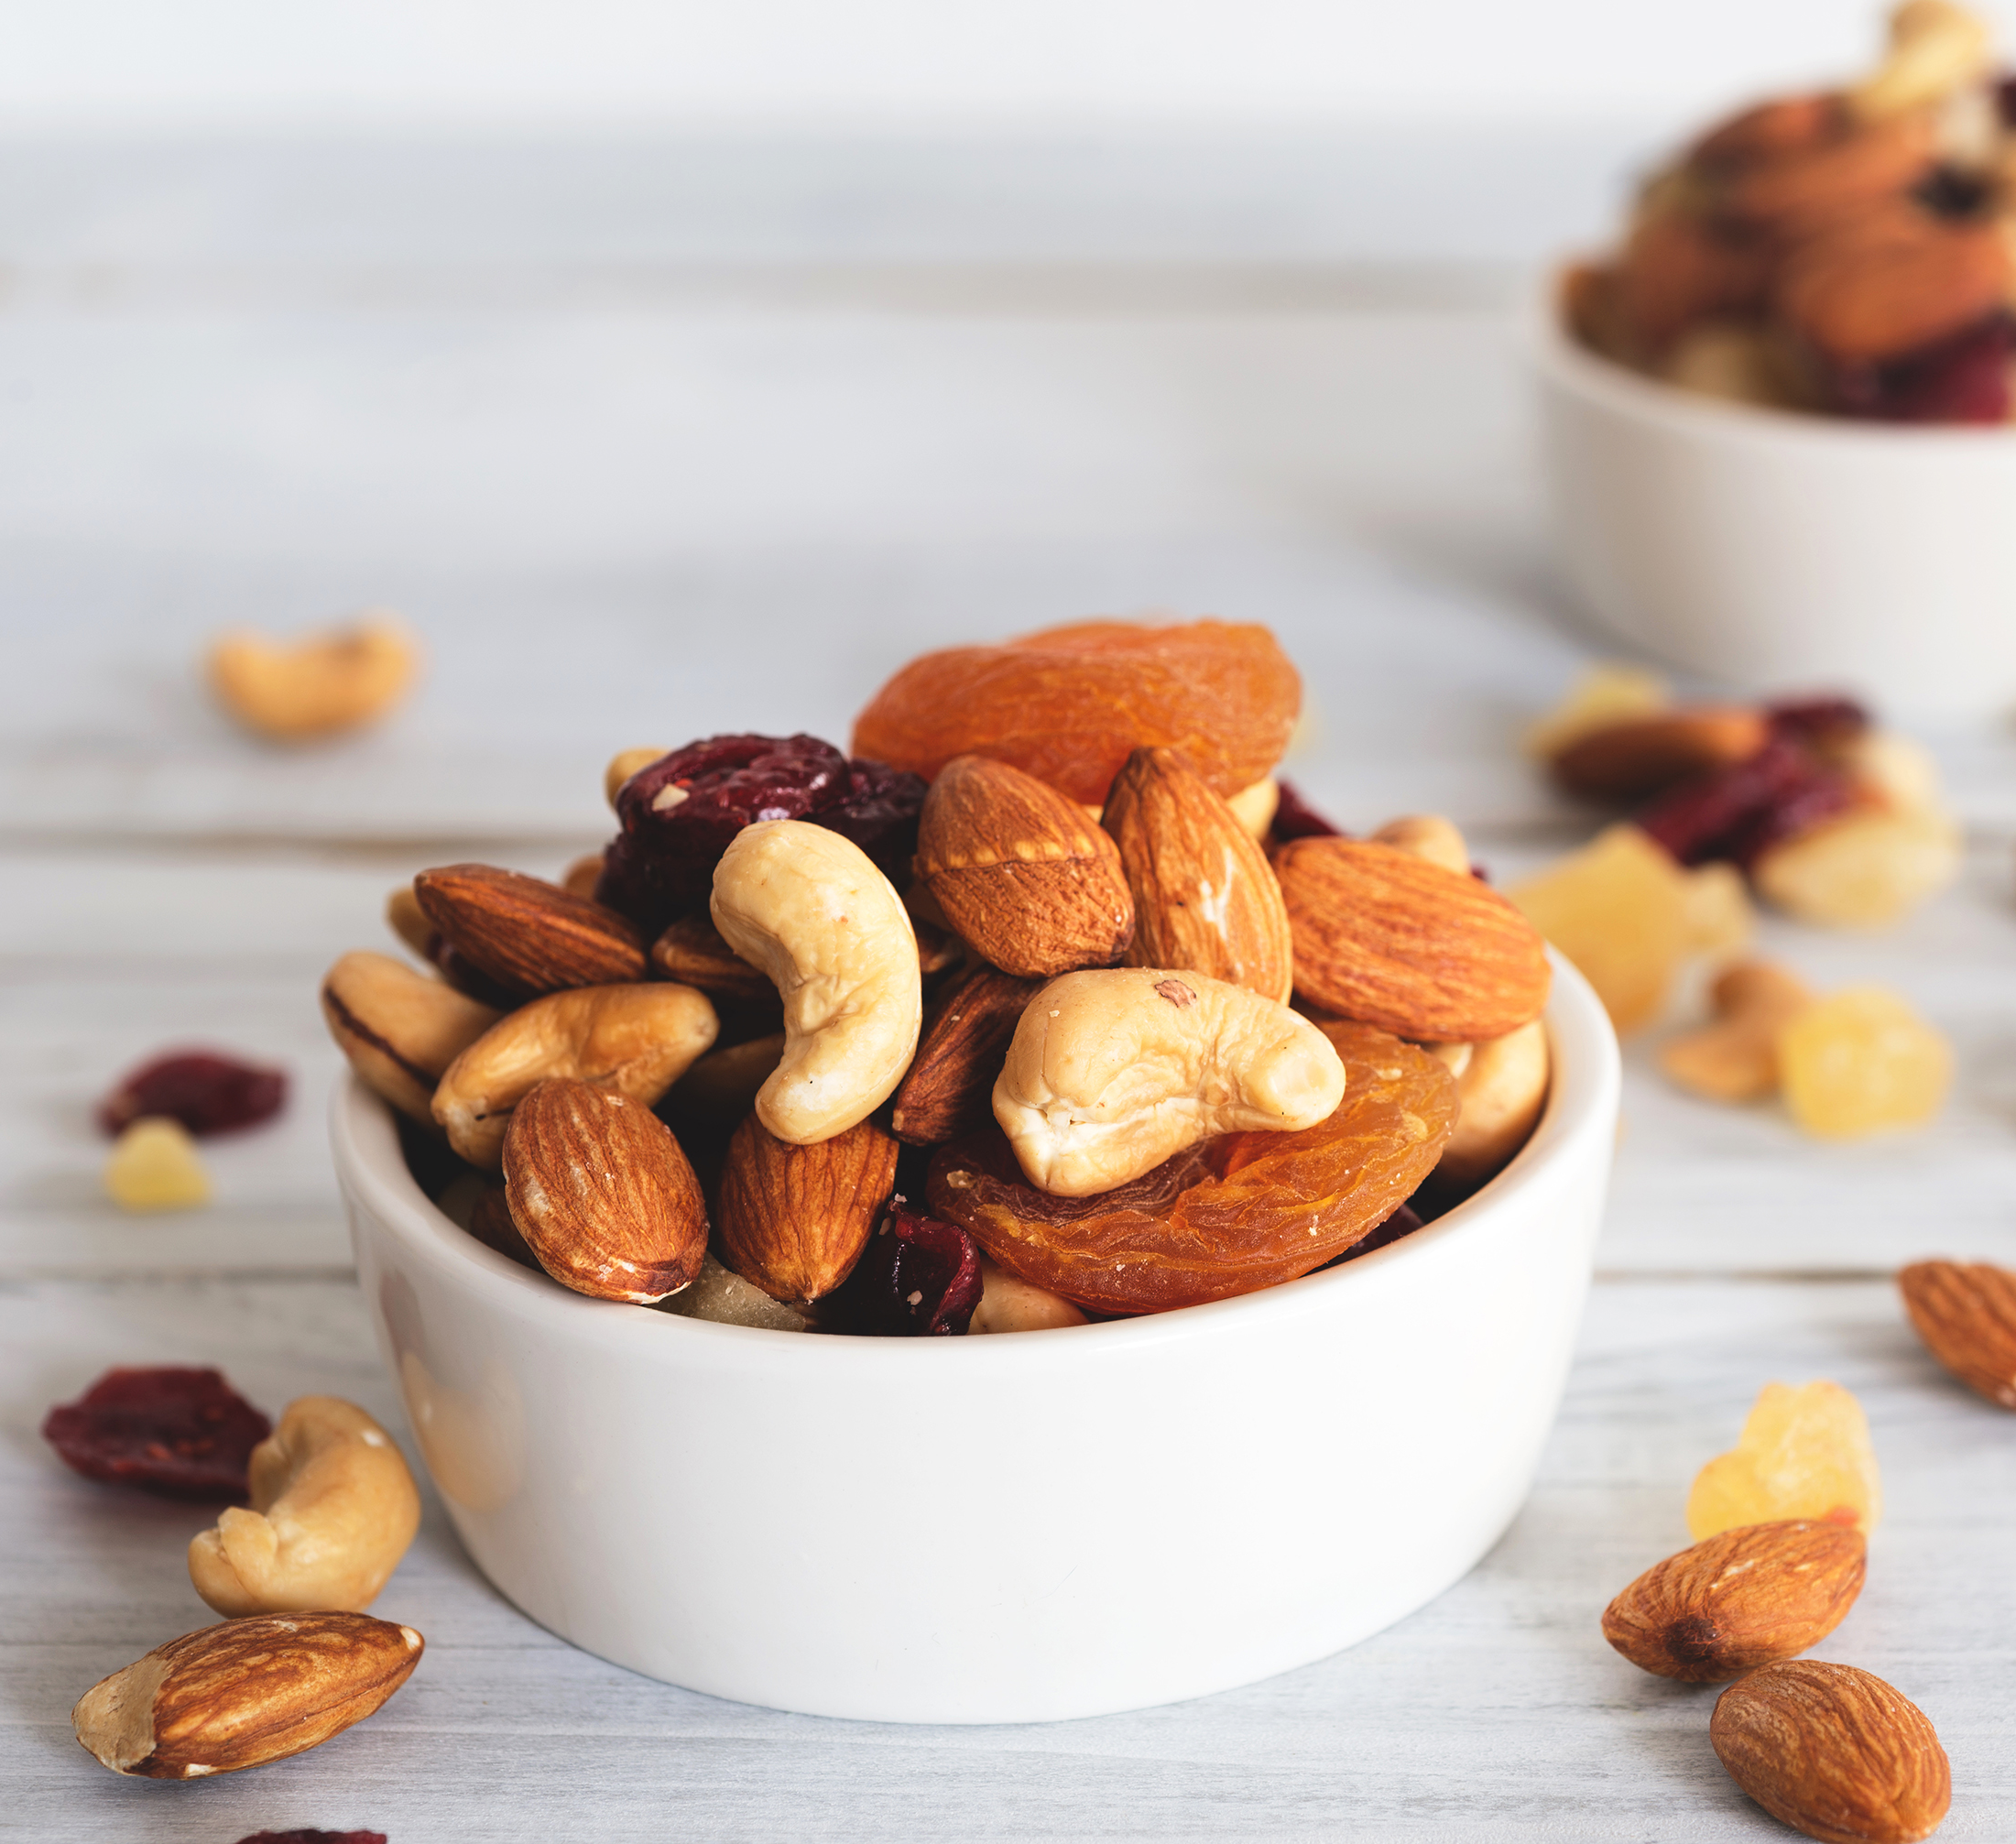
Green Leafy Salad: Adapted from PCC’s Emerald City Salad
½ cup chopped fennel bulb
1 diced red / yellow pepper
½ cup chopped Italian parsley
Toasted almond (optional)
Gorgonzola cheese (optional)

Slide 21
Green Leafy Salad: Adapted from PCC’s Emerald City Salad
Cook Wild Rice according to package instructions.
Combine olive oil, lemon juice, garlic, pepper and salt in bowl. Top with fennel, red pepper, parsley and then green leafy vegetables.
While rice is still warm, spread on top of the greens, Once the rice cools to room temperature, toss ingredients together.
Adapted from Emerald City Salad Recipe, Retrieved 12/30/22 from: https://www.pccmarkets.com/recipe/pcc-emerald-city-salad/

Slide 22
Benefits of Fresh Salmon
Rich source of Omega-3 fatty acids
Alaskan Salmon still considered low in Mercury contamination
4 oz Salmon contains:
127.8% Daily Value Vitamin D
Almost 100% Vitamin B12 / Tryptophan
53% Protein
8% Calories

Slide 23
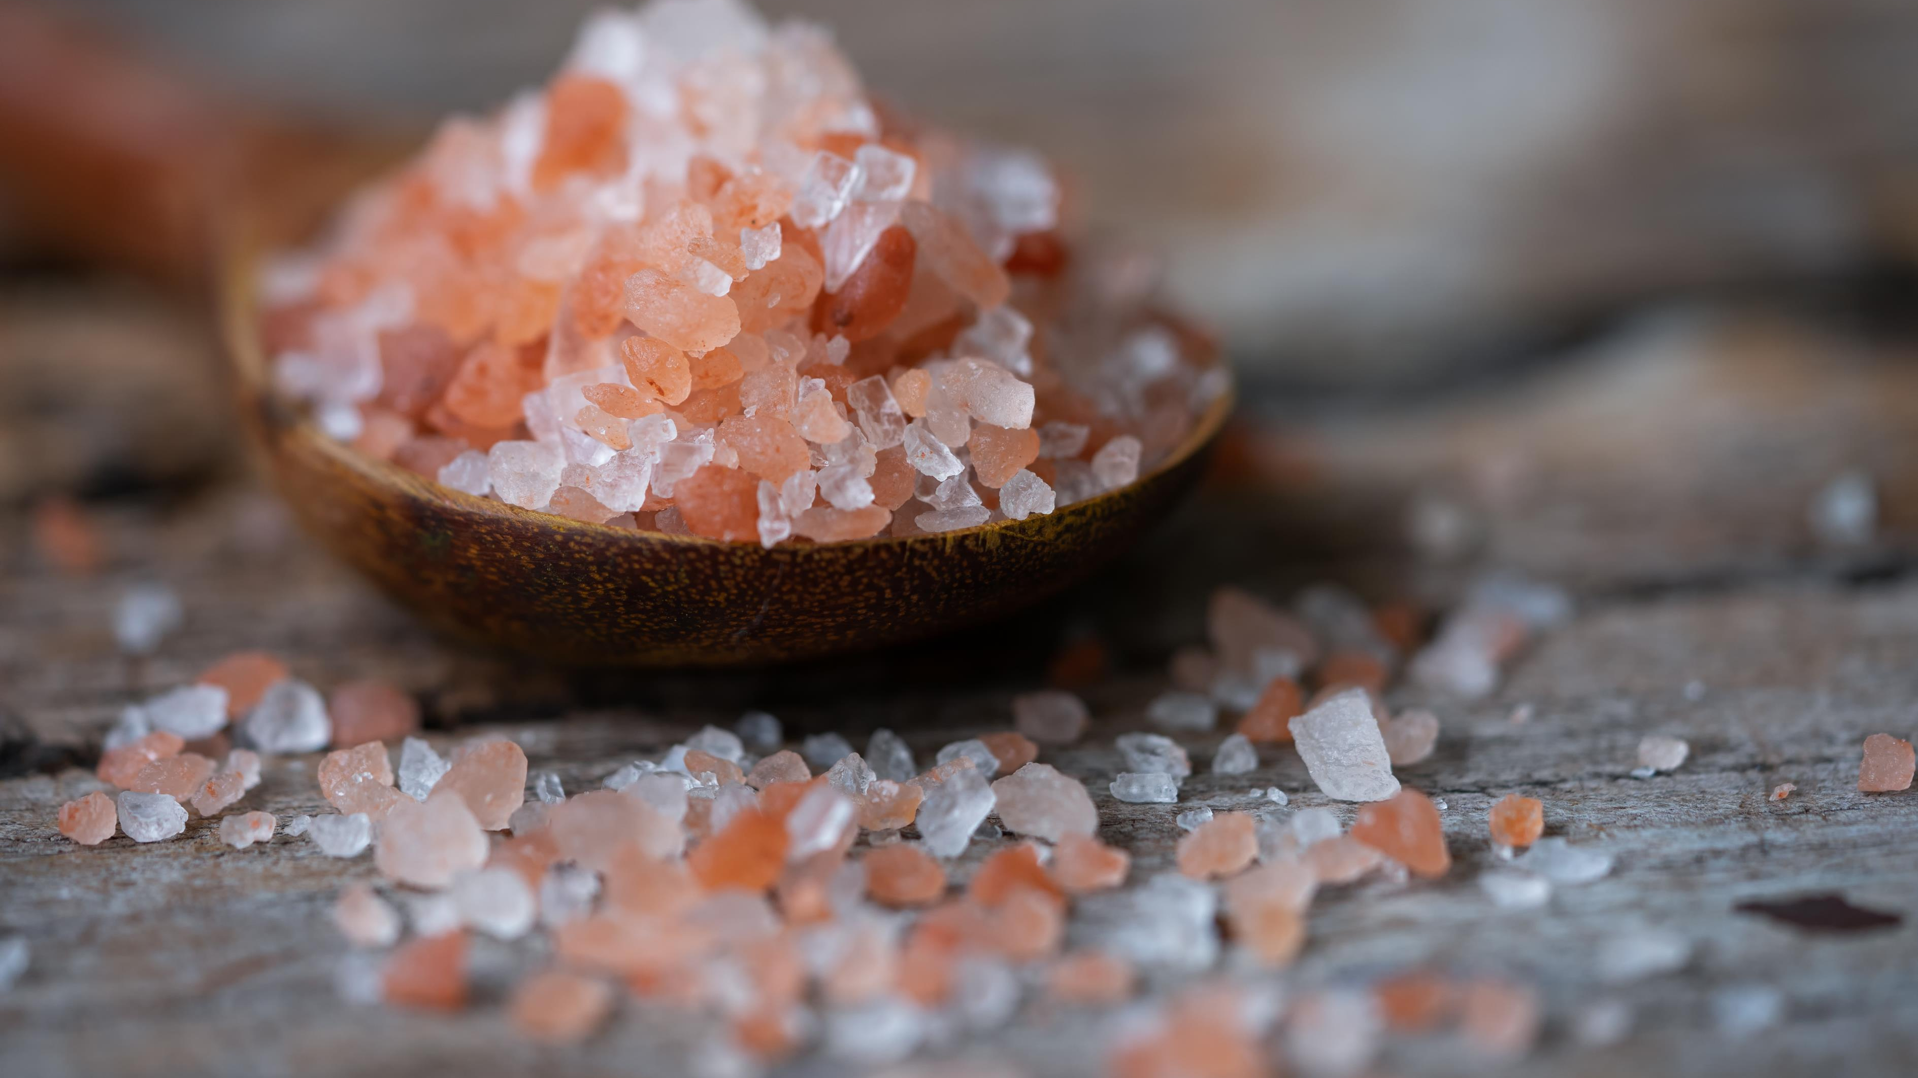
Baked Salmon Ingredients
2 cloves garlic, minced
6 tablespoons light olive oil
1 teaspoon dried basil
1 teaspoon salt
1 teaspoon ground black pepper
1 tablespoon lemon juice
1 tablespoon fresh parsley, chopped
2 (6 ounce) fillets salmon

Slide 24
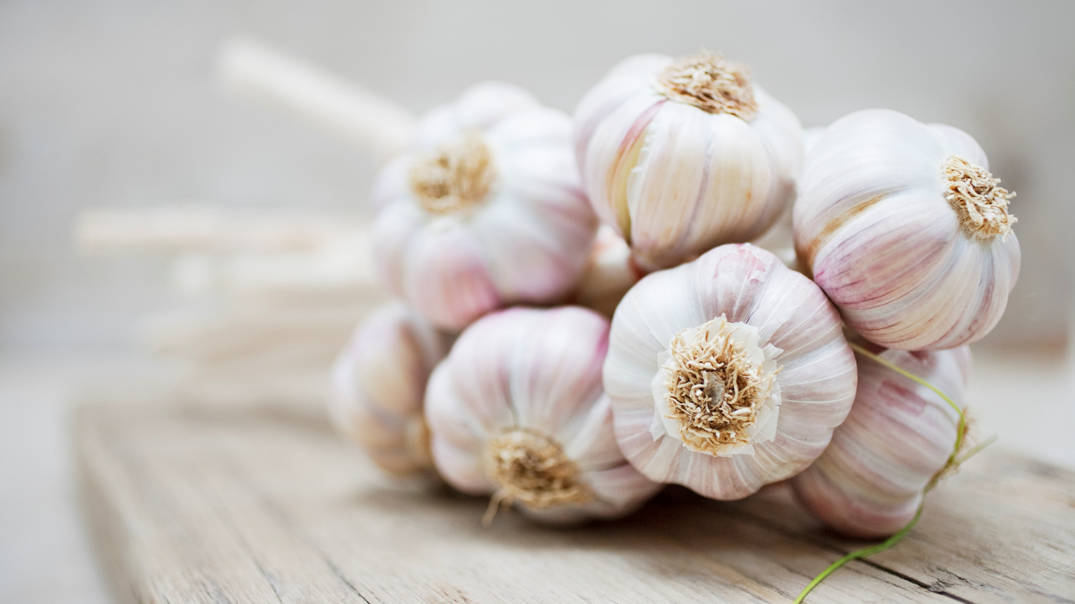
Baked Salmon
Combine garlic, olive oil, basil, salt, pepper, lemon juice, and parsley
Place Salmon in a medium baking dish and cover with marinade. Cover with foil and place in fridge for 1 hour.
Preheat oven to 375 degree F
Recoat fish with marinade and place in oven to bake for 35-45 minutes. Check for flakiness at 35 minutes
Adapted from recipe: Retrieved 12/30/22 from :
https://www.allrecipes.com/recipe/34746/baked-salmon-ii/

Slide 25
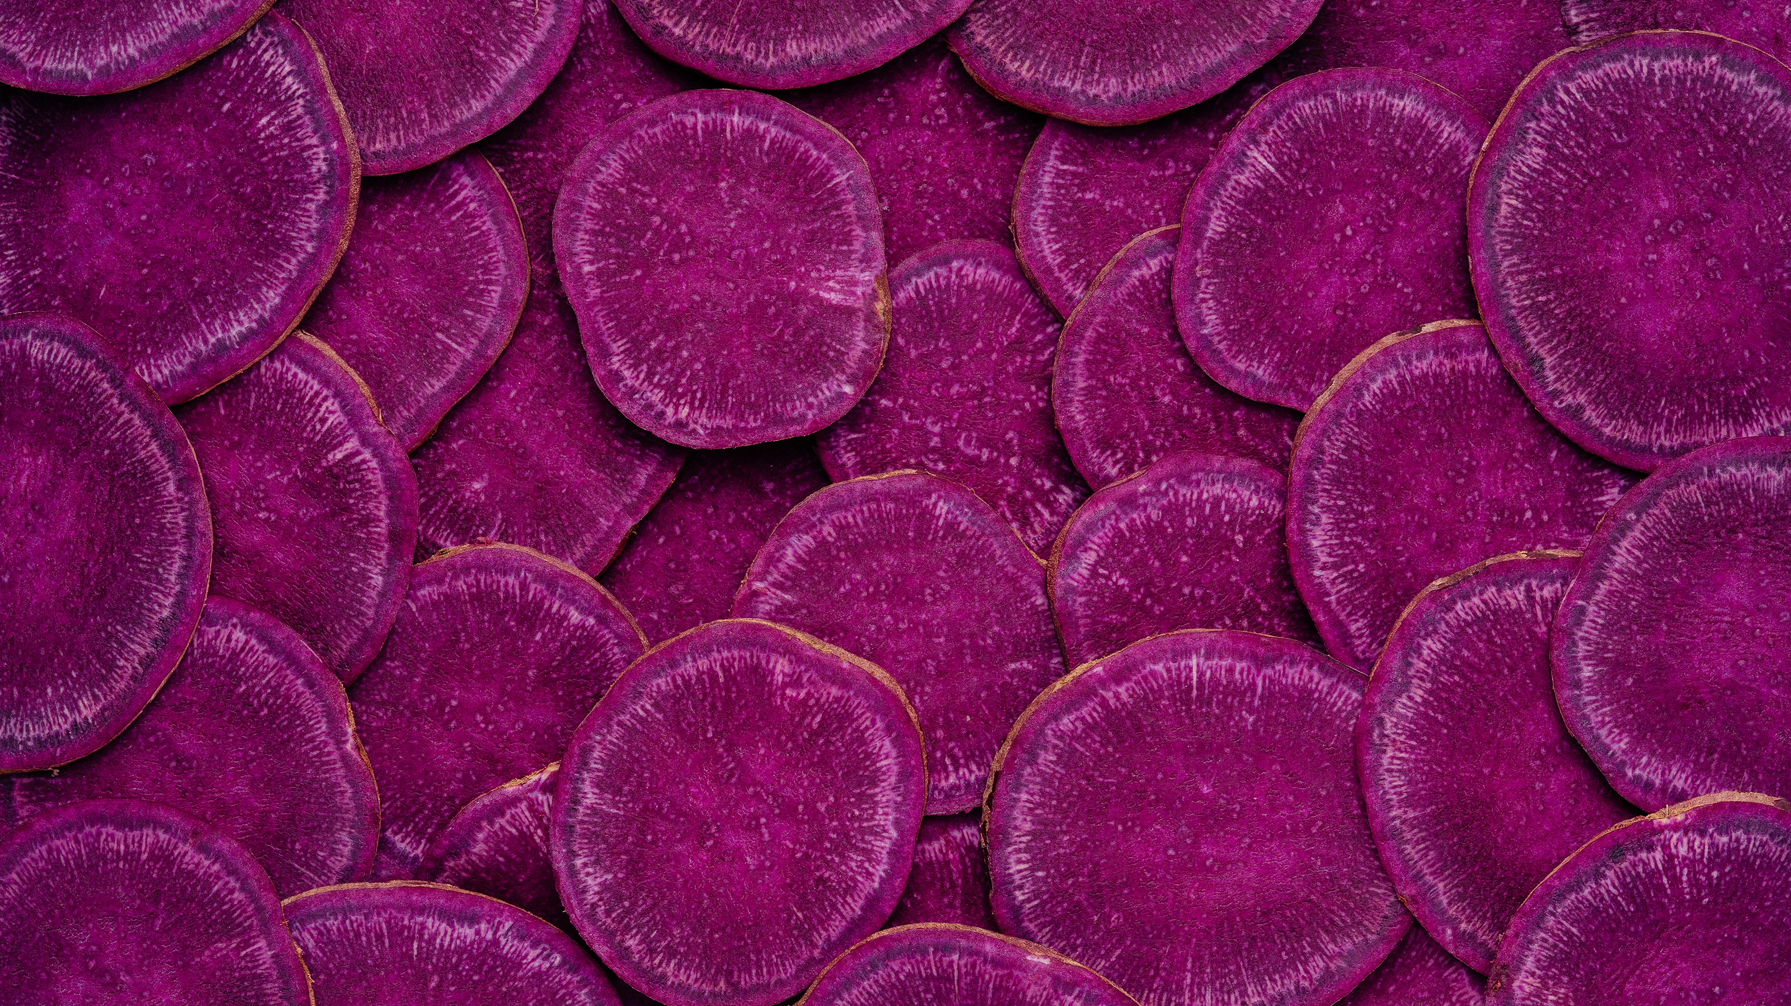
Beet Red Soup
A Gorgeous addition to any meal
Easy to prepare and full of nutrition
Beets are a great source of betalains – antioxidant, anti-inflammatory, and supportive in liver detoxification
1 cup lentils packed with protein (about 18 grams) and fiber (15.6 grams)

Slide 26
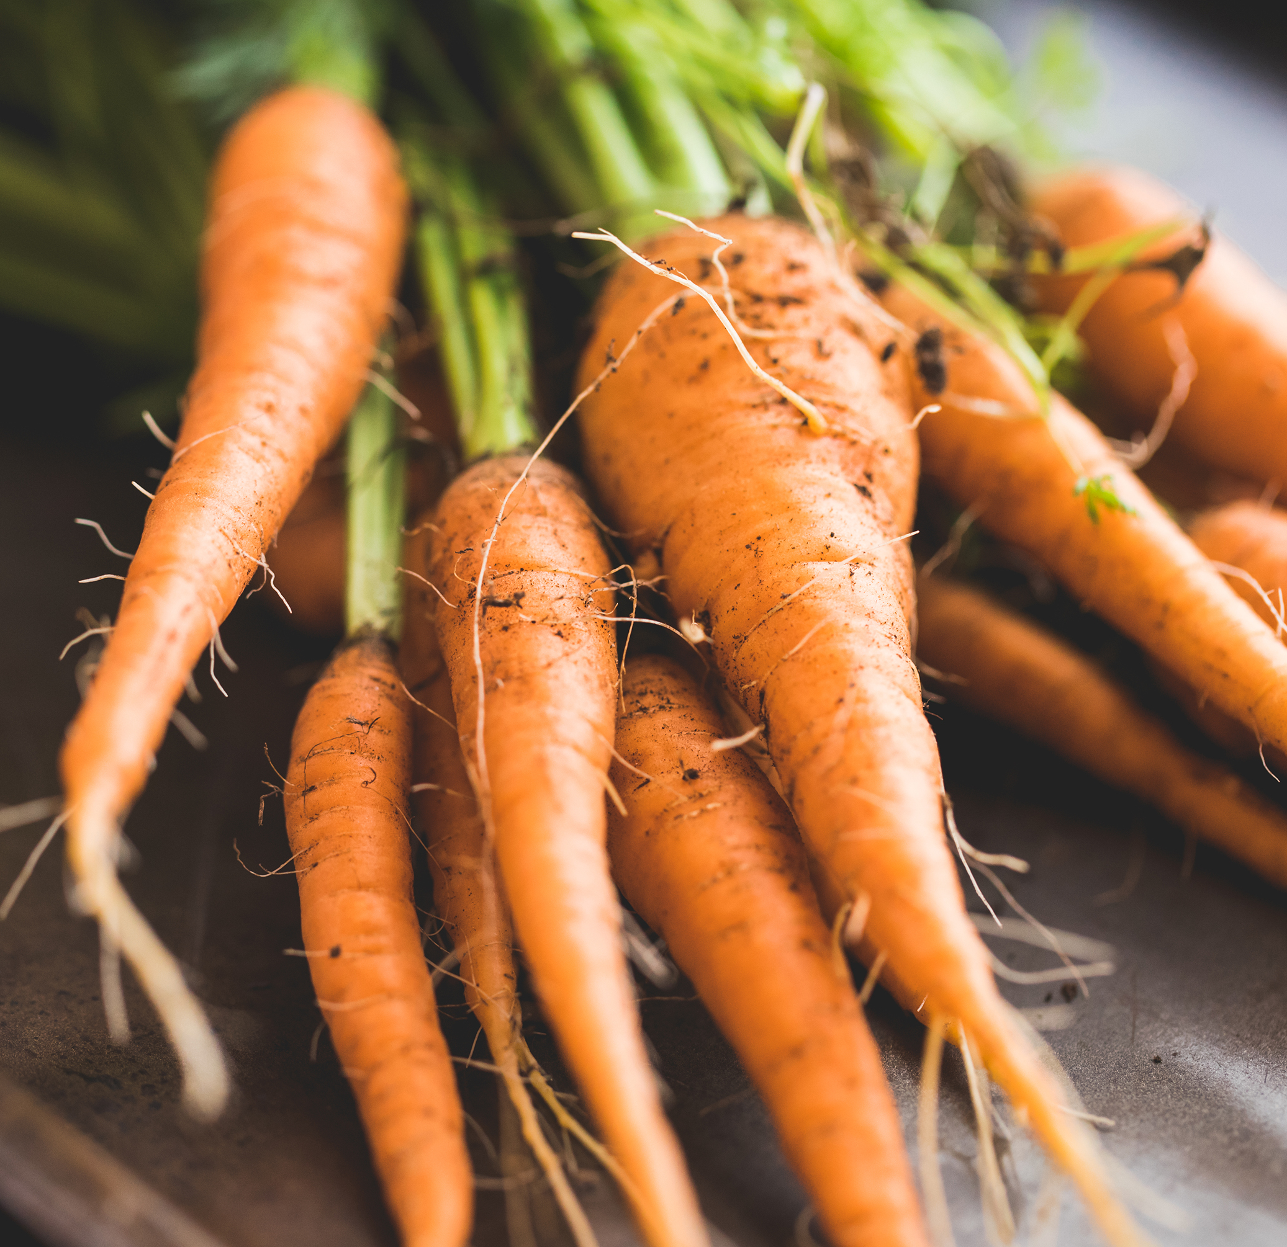
Beet Red Soup: Ingredients
3 medium carrots, chopped
1 beet, chopped
1 tablespoon extra-virgin olive oil
1 large onion, diced
2 tablespoons fresh chopped rosemary
1 tablespoon fresh oregano
1 cup dried red lentils
2 bay leaves
4 cups vegetable stock
2 tablespoons light miso

Slide 27
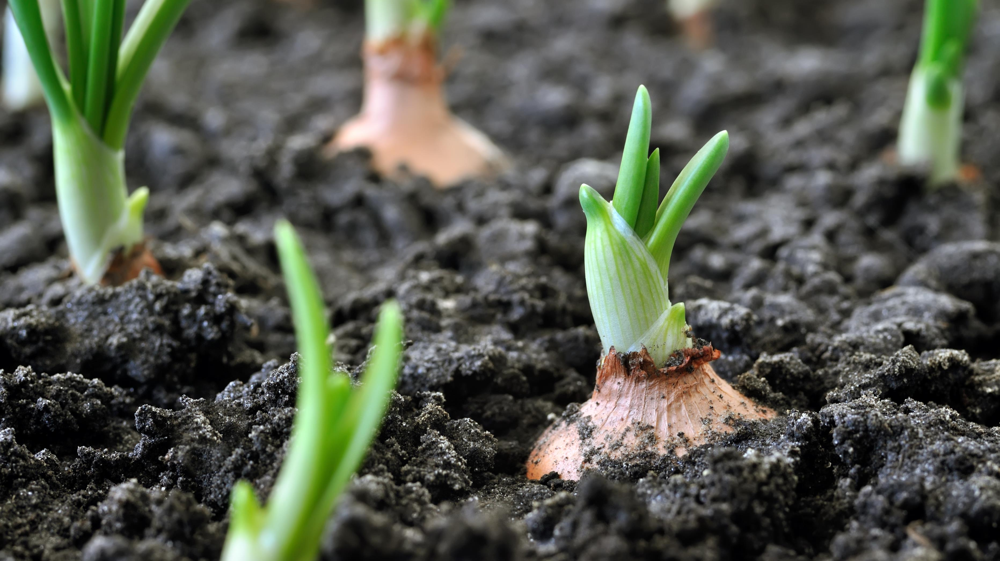
Beet Red Soup: Preparation
Chop carrots and beets
Sauté diced onion with oil in a large soup pot
Once onion is soft, add carrots and beet – sauté for a few more moments
Add chopped rosemary and oregano, bay leaves, washed and drained lentils, and stock to vegetables
Bring to a boil, then lower heat and simmer for 40 minutes

Slide 28
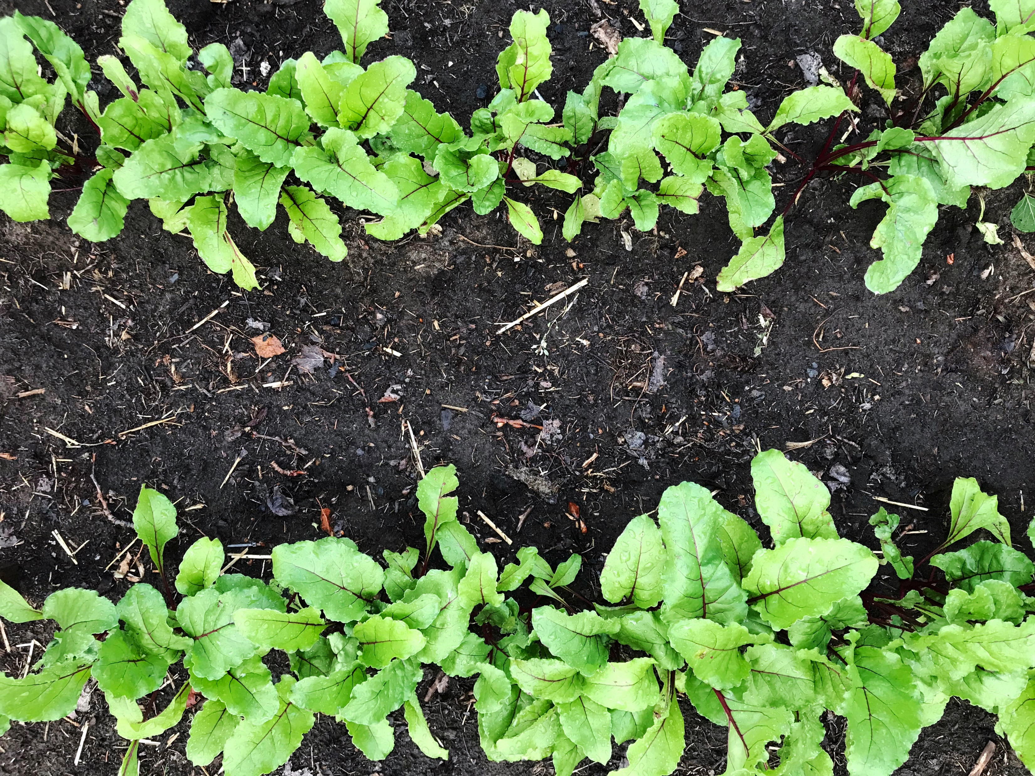
Beet Red Soup: Preparation Continued
Important Step: Remove Bay Leaves!
Once soup has cooled, puree in a blender or use immersion blender.
Add miso to ½ cup water to dissolve and stir into soup
Reheat before serving
Recipe adapted from: Rosemary Red Soup Recipe – Feeding the Whole Family by Cynthia Lair (Sasquatch Books)

Slide 29
Recipe Resources
Feeding the Whole Family- by Cynthia Lair, Book designed to help prepare one meal that can satisfy all age groups
Vegweb.com – Vegetarian and Vegan Recipes packed with nutrients in a convenient layout, easy to search and navigate
Cookusinterruptus.com – Videos of recipe preparation with a light touch of humor to go along
The New Moosewood Cookbook – by Mollie Katzen – Focused on vegetarian recipes and helpful cooking tips

